Slide 1
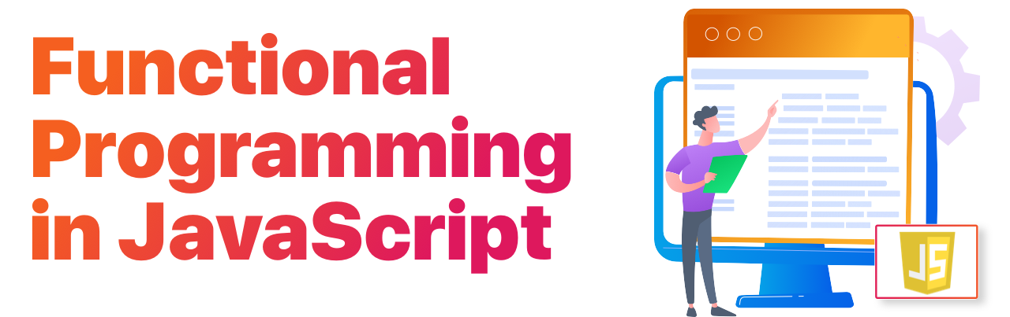
Modern Javascript
BDDF Socle - 2023

Slide 2

introduction

Slide 3
Why is JavaScript so Important?
JS inside HTML => HTML inside JS (JSX)
Inputs
const WelcomeView = ({ name }) => ( <h1> Hello, {name} </h1> );
Output: view to render

Slide 4
Javascript ecosystem main parts
Webpack (bundler)
Babel (transpiler)
Eslint (static code analyzer)
Node js (runtime)
npm (package manager)
Browser (Chrome, Firefox, …)
ECMAScript

Slide 5

Ecmascript vs javascript
ECMAScript is a specification.
JavaScript is an implementation of the ECMAScript standard.

Slide 6
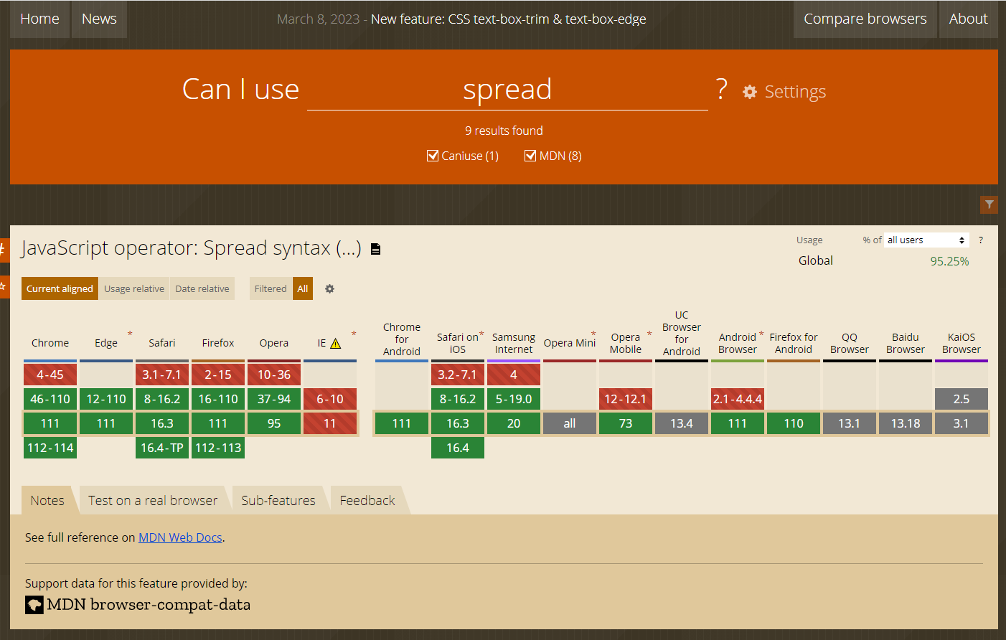
Can i use
https://caniuse.com/?search=spread

Slide 7
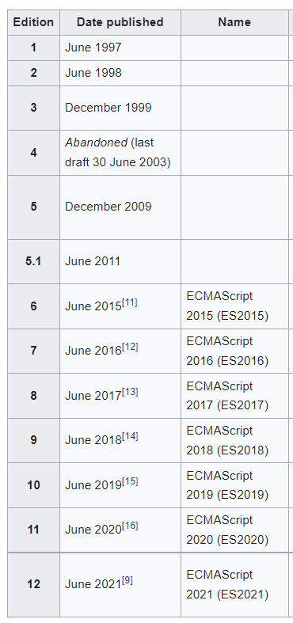
ECMASCRIPT VERSIONS
https://262.ecma-international.org/12.0/

Slide 8
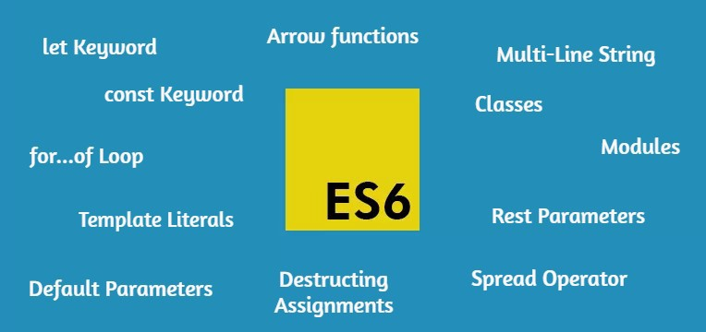
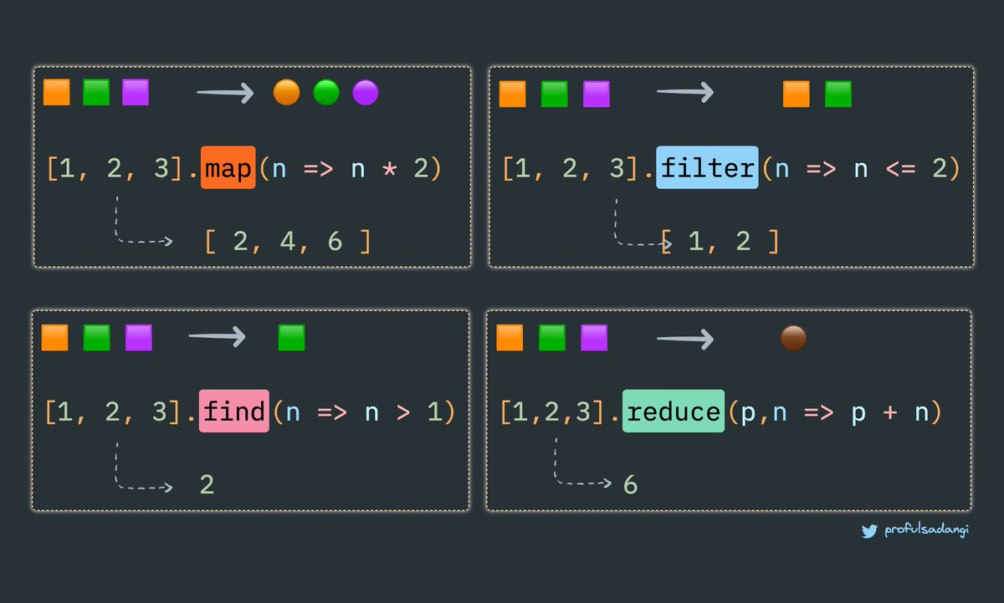
ES6 main features

Slide 9
Part 1: fundamentals of functional programming
Why functional programming ?
Pure functions and side effects
Imperative vs Declarative
Arrow functions
Mutable vs Immutable
High order functions
Map / Filter / Reduce
Every / Some
Chaining
Rest / Spread / Destructing
Optional chaining
Nullish coalescing
Tips
Practices

Slide 10
JS is a multi-paradigms language
1
2
Procedural
Functional
3
Object Oriented

Slide 11

which approach will we choose to have a clean and clear code?

Slide 12
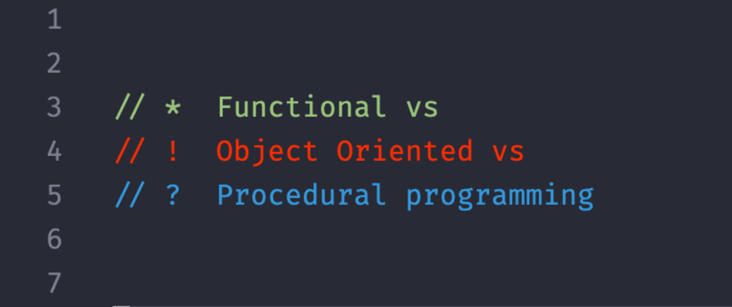

Slide 13
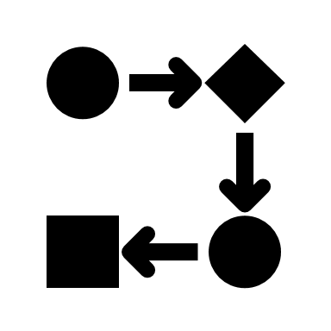
What’s procedural programming?
A programming paradigm, derived from imperative programming. Based on the concept of the procedure call. More like a step-by-step approach when writing a program. You write codes as a step-by-step set of instructions.

Slide 14

What’s object oriented programming?
Object-oriented programming breaks down a programming task into objects that expose behavior (methods) and data (members or attributes) using interfaces.

Slide 15

What’s functional programming (FP) ?
Functional programming is a programming paradigm where programs are constructed by applying and composing functions. It is a declarative programming paradigm in which function definitions are trees of expressions that map values to other values.
It's easier to read, reuse, test, and manage. Each function doesn't do more than one thing. It is more about passing data from function to function to function until you get your desired result.
Most of the functions are pure. This literally means it has no side-effect and data should be immutable. You create a function that does only one thing and doesn't change anything outside it scope.

Slide 16
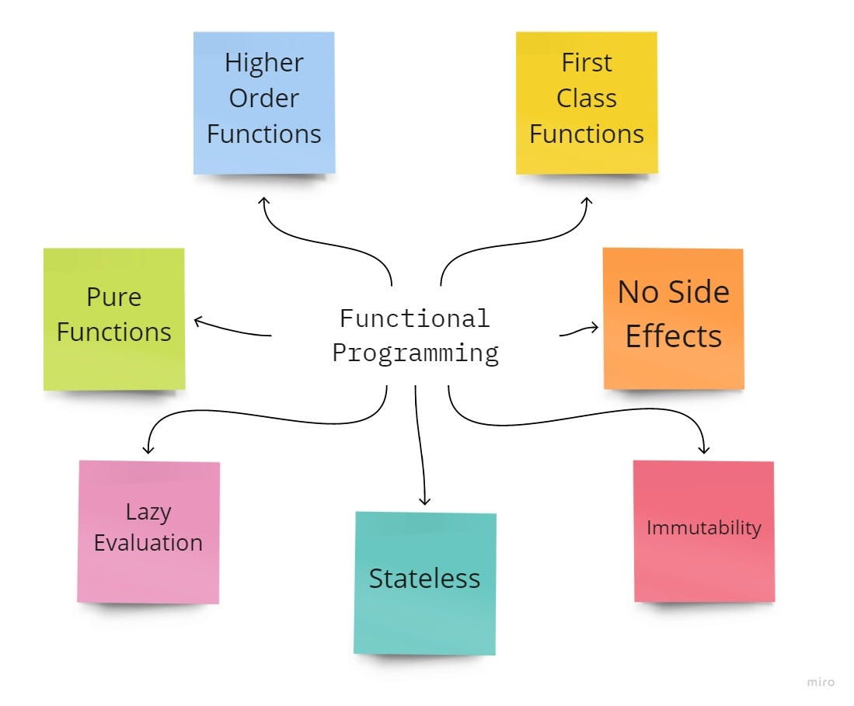
Functional programming

Slide 17
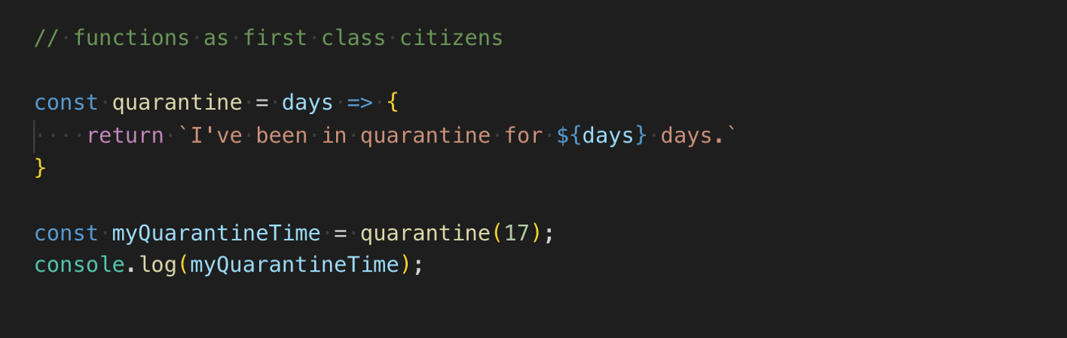
Assigned to variables
Passed as arguments to functions
Returned from functions
JavaScript has first-class functions

Slide 18
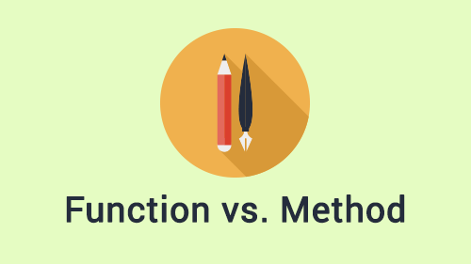
/** * encode value to base 64 * @param {string} value * @return {string|null} */ const encodeBase64 = (value) => { if (value && value.length) { const valueBuffer = Buffer.from(value); return valueBuffer ? valueBuffer.toString('base64') : ''; } return null; }; /** * decode value from base 64 * @param {string} value * @return {string|null} */ const decodeBase64 = (value) => { if (value && value.length) { const valueBuffer = Buffer.from(value, 'base64'); return valueBuffer ? valueBuffer.toString('ascii') : ''; } return null; }; const StringUtils = { encodeBase64, decodeBase64, }; export default StringUtils;
Function As a standalone thing not necessarily attached to a class.
Module

Slide 19
import React from 'react'; import PropTypes from 'prop-types'; import { Chrono, } from 'react-chrono'; import HouseConfig from '../config/HouseConfig'; const { TIMELINE_SETTINGS, } = HouseConfig; const HouseChrono = ({ chronoItems, scrollable, hideControls, mode, }) => ( <Chrono allowDynamicUpdate hideControls={hideControls} scrollable={scrollable} mode={mode} theme={TIMELINE_SETTINGS} cardHeight={100} items={chronoItems} /> ); // propsType (validation) HouseChrono.propTypes = { chronoItems: PropTypes.arrayOf(PropTypes.shape({ time: PropTypes.string, version: PropTypes.string, })).isRequired, scrollable: PropTypes.bool.isRequired, hideControls: PropTypes.bool.isRequired, mode: PropTypes.string.isRequired, }; export default HouseChrono;
Function As a standalone thing not necessarily attached to a class.
Component (Function)

Slide 20
const postSaisieOstEtape3Query = async (baseUrl, params) => { const url = `${baseUrl}${POST_SAISIE_OST_ETAPE3_SERVICE_PATH}`; const formData = convertDataToFormParams({ an200_idTransaction: params.idTransaction, }); return AxiosWrapper({ method: 'post', url, data: formData, }); }; const getAccountEligibleOstQuery = async (baseUrl, params) => { let url = `${baseUrl}${GET_ACCOUNT_ELIGIBLE_OST_SERVICE_PATH}`; url += `?an200_compte=${params.numCompte}`; url += `&an200_codeGuichet=${params.codeGuichet}`; return AxiosWrapper({ method: 'get', url, }); }; const getFusionPdfQuery = async (baseUrl, params) => { const url = `${baseUrl}${GET_FUSION_PDF_SERVICE_PATH}?an200_referenceTechnique=${params.referenceTechnique}`; return AxiosWrapper({ method: 'get', url, }); }; const SuiviOstApi = { getAccountEligibleOstQuery, postSaisieOstEtape3Query, postSaisieOstEtape2Query, getGetExistanceAvisOstQuery, postInitSaisieOstQuery, getDetailOstQuery, getSuiviOstListQuery, getInCacheEtape2Query, getFusionPdfQuery, };
Function As a standalone thing not necessarily attached to a class.
Module

Slide 21
Class exist only to handle side effects
@Reduxify((state) => ({ // define state to extract ...AwtContextFragment(state), ...SuiviOstListFragment(state), ...CompteTitresListFragment(state), }), { // define actions to execute ...SuiviOstDispatcher, ...CommonsDispatcher, }) @withPageLayout( { selectedTab: 'ordre', } ) @MarcheLocalizedFragment(SuiviOstDico) class SuiviOstHomePage extends Component { // default props static defaultProps = { ...SuiviOstDefaultProps, }; // propsType (validation) static propTypes = { ...SuiviOstPropsTypes, }; // did mount stuff componentDidMount() { this.initPage(); } initPage = () => { const { requestSuiviOstList, requestCompteTitresList, } = this.props || {}; requestCompteTitresList(); const compteSelected = decodeUrlParams(paramByName(this.props)('compteSelected')); const [ libelleCompte, codeGuichetOrigine, numCompte, ] = compteSelected?.split(' ') || []; requestSuiviOstList({ libelleCompte, codeGuichetOrigine, numCompte, }); };

Slide 22
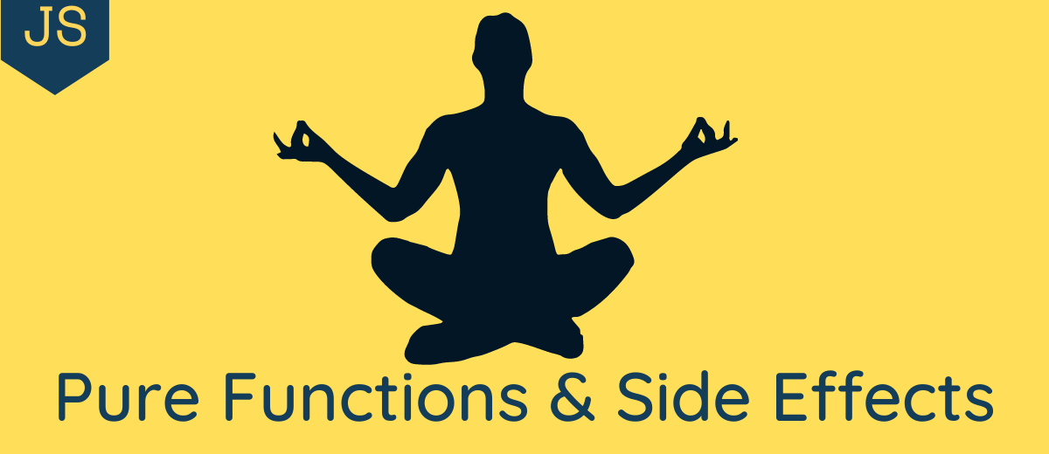

Slide 23
what is a side effect?
Mutating(changing) the input(s) of the function.
1
Querying/Updating DOM
3
Logging(even in the console)
4
Making an XHR/fetch call.
5
Depending on an outer state.
2
Localstorage
6
Routing
7

Slide 24
Side effect
Side effect
Side effect
Pure/déterminsite/stable

Slide 25

Let’s see Some bad functions

Slide 26

before
const greeting = 'Hello'; const sayGreeting = (name) => `${greeting} ${name}`;
const findUser = (users, item) => { const reversedUsers = users.reverse(); const found = reversedUsers.find((user) => user === item); document.getElementById('user-found').innerText = found; };
// When greeting is "Hello"
sayGreeting('Alex'); // Returns, "Hello Alex"
// When greeting is "Hola"
sayGreeting('Alex'); // Returns, "Hola Alex"
reverse is a mutation !
We are mutating the input.
We are querying and manipulating the DOM

Slide 27
before
const tax = 20; const calculatePriceWithTax = (productPrice) => (productPrice * tax) / 100 + productPrice;
const isImpure = () => new Date();
const isImpure = () => Math.random();

Slide 28
before
const addToCart = (cart, item, quantity) => { cart.items.push({ item, quantity, }); return cart; };

Slide 29
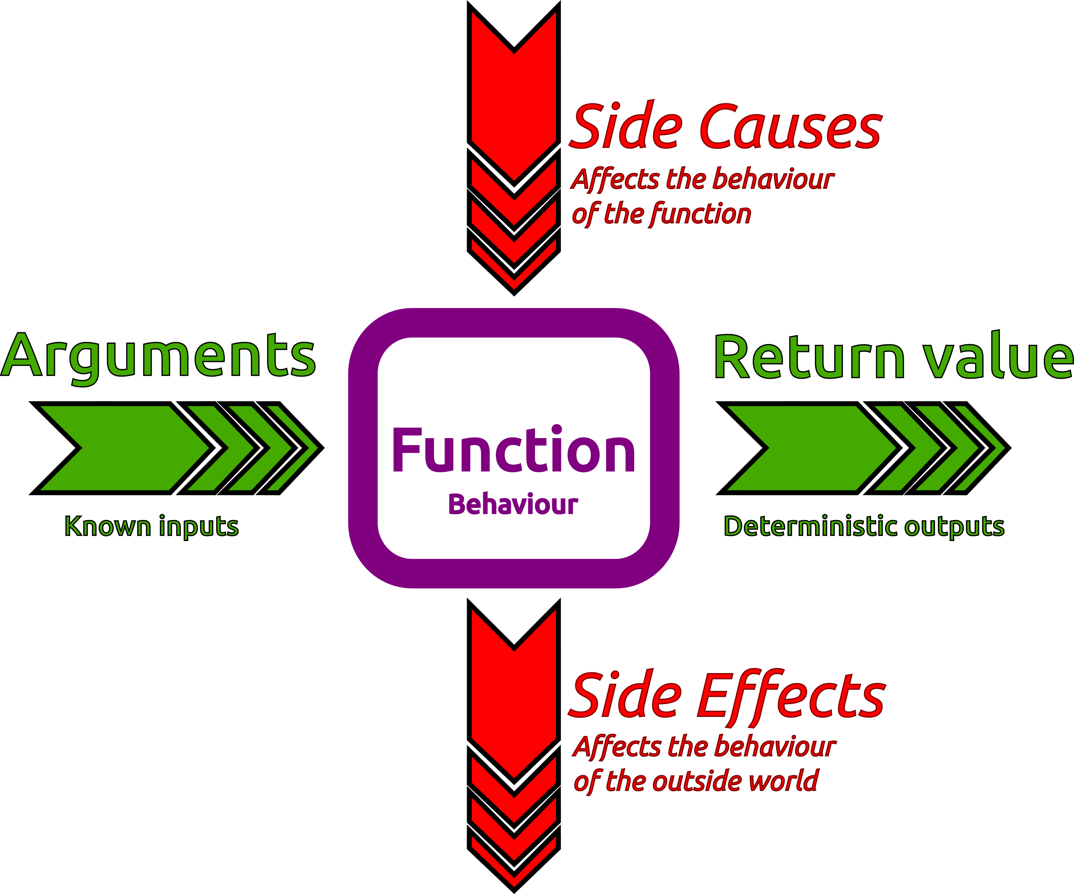
Impure function

Slide 30

after
const findUser = (users, item) => { // Create a shallow copy of users array and then reverse const reversedUsers = [...users, ].reverse(); // Find the element in the cloned array const found = reversedUsers.find((user) => user === item); // Return the found element return found; };

Slide 31
after
const calculatePriceWithTax1 = (productPrice, tax) => (productPrice * tax) / 100 + productPrice;
const calculatePriceWithTax2 = (productPrice) => { const tax = 20; return (productPrice * tax) / 100 + productPrice; };

Slide 32
after
const addToCart = (cart, item, quantity) => ({ ...cart, items: [ ...cart.items, { item, quantity, }, ], });

Slide 33
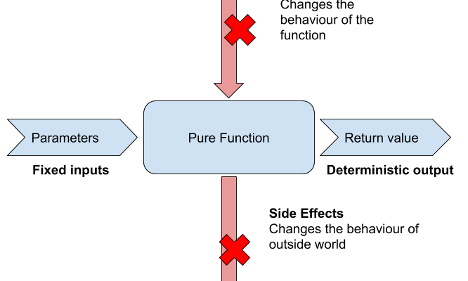
pure function

Slide 34
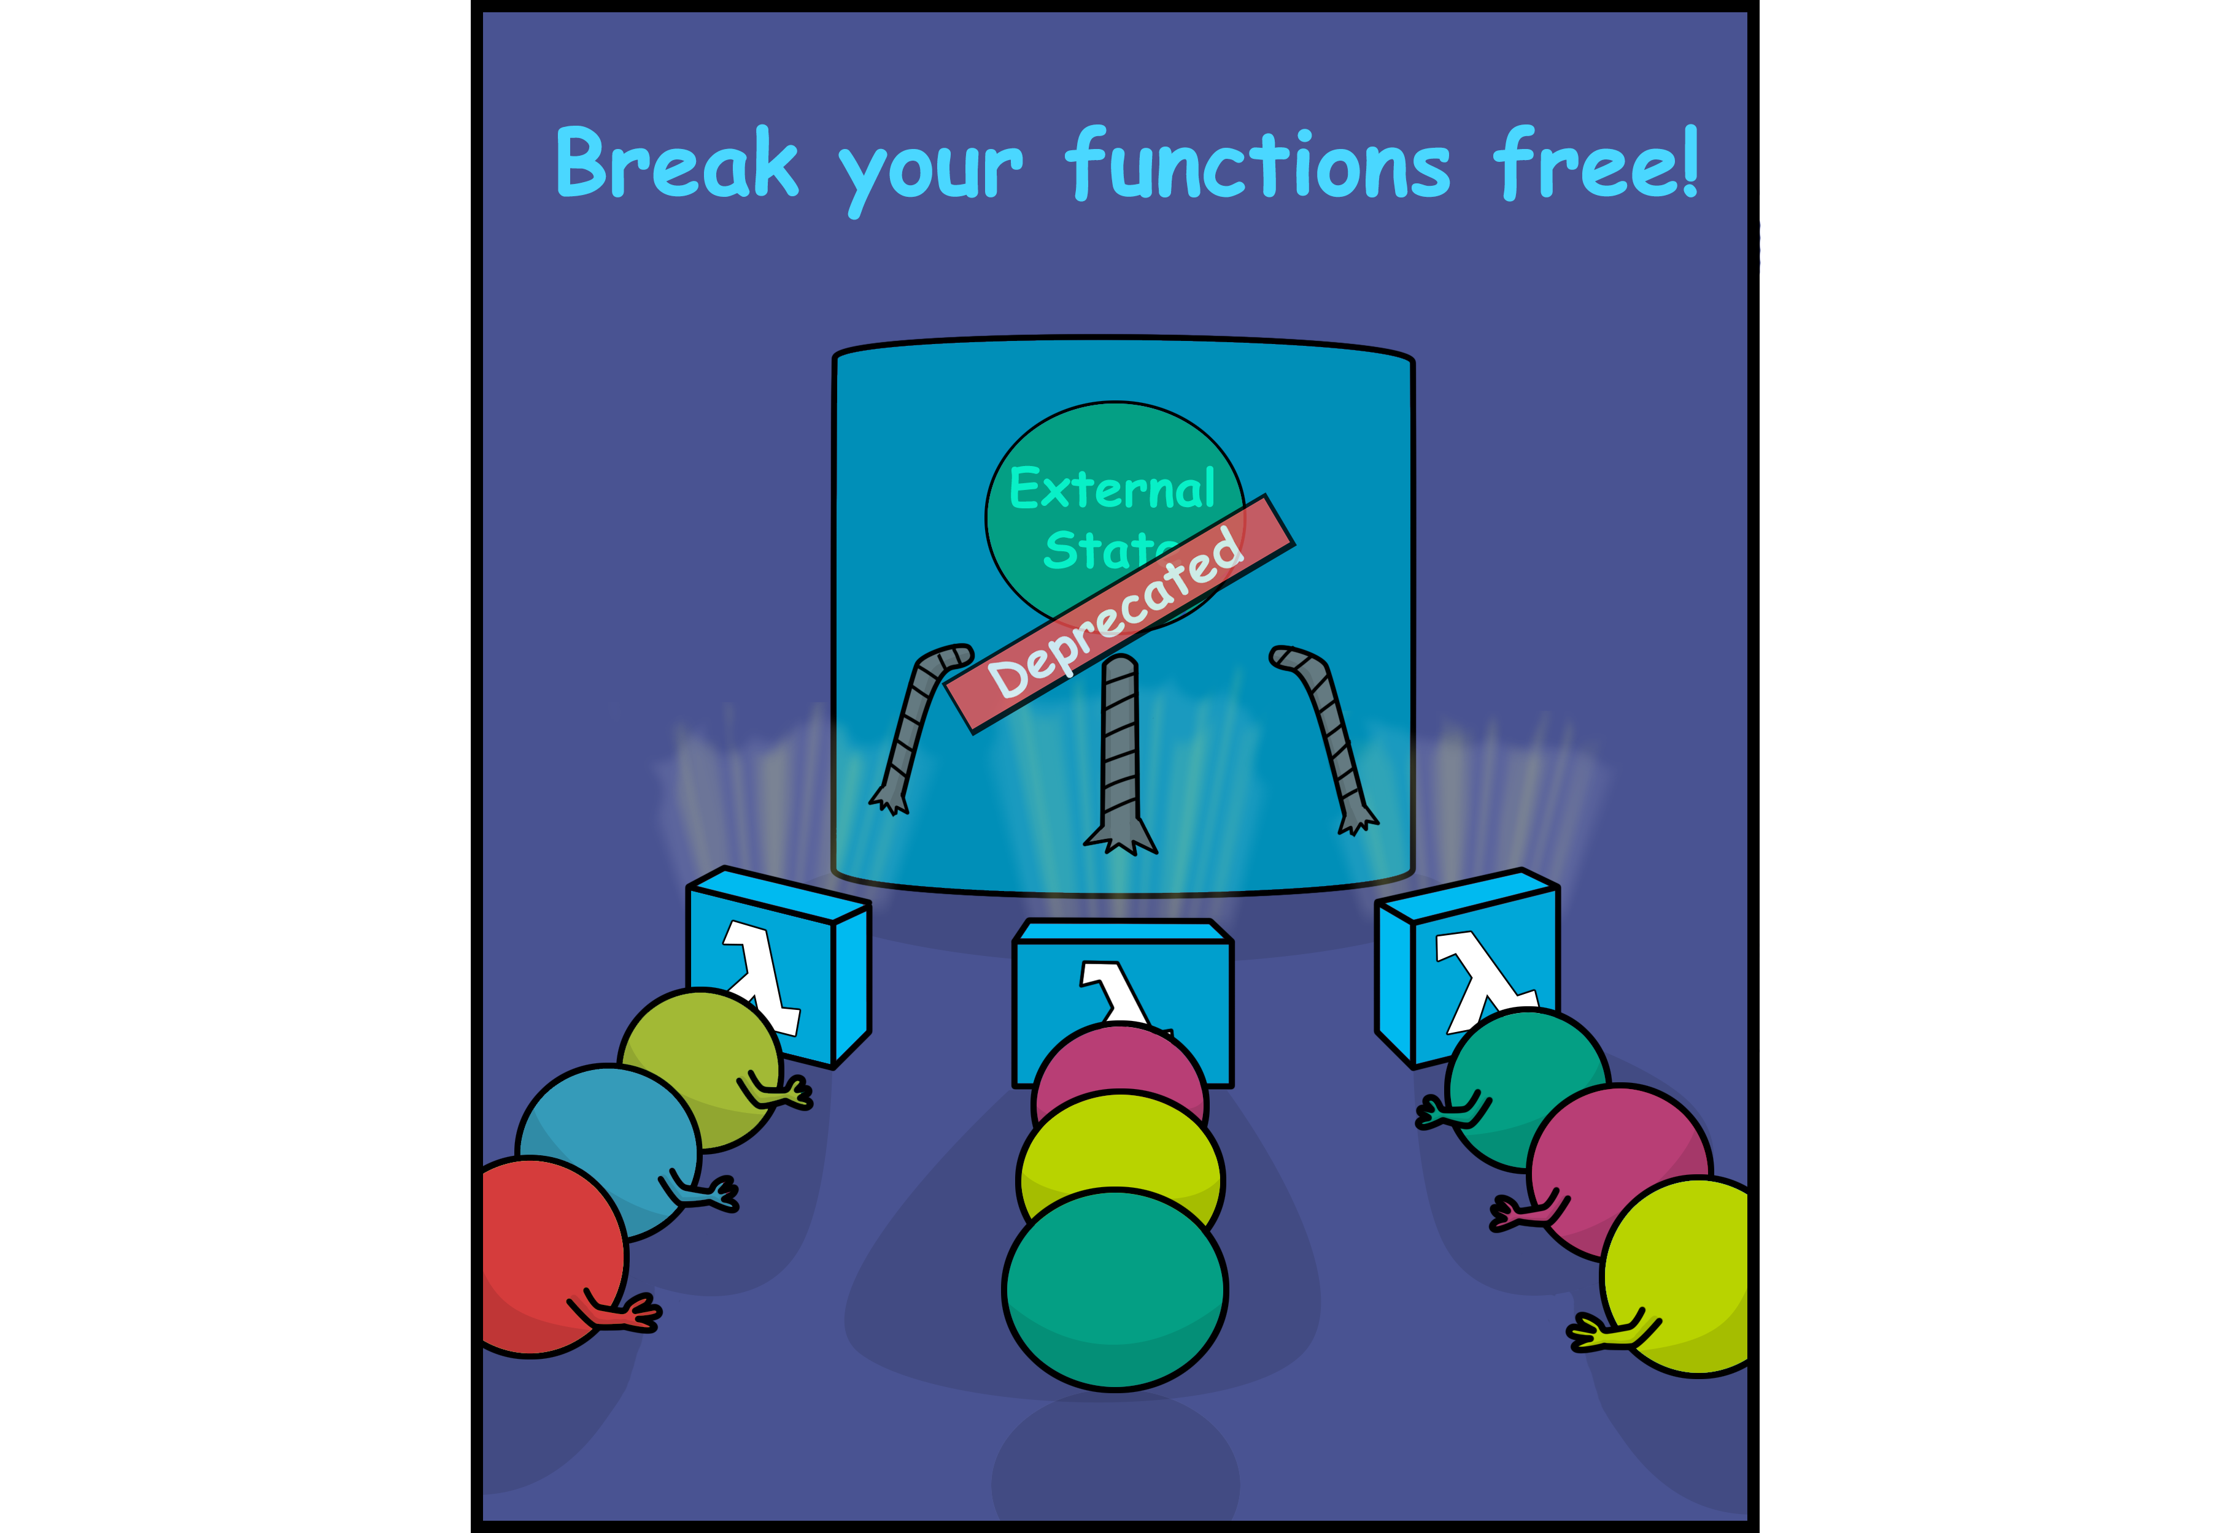
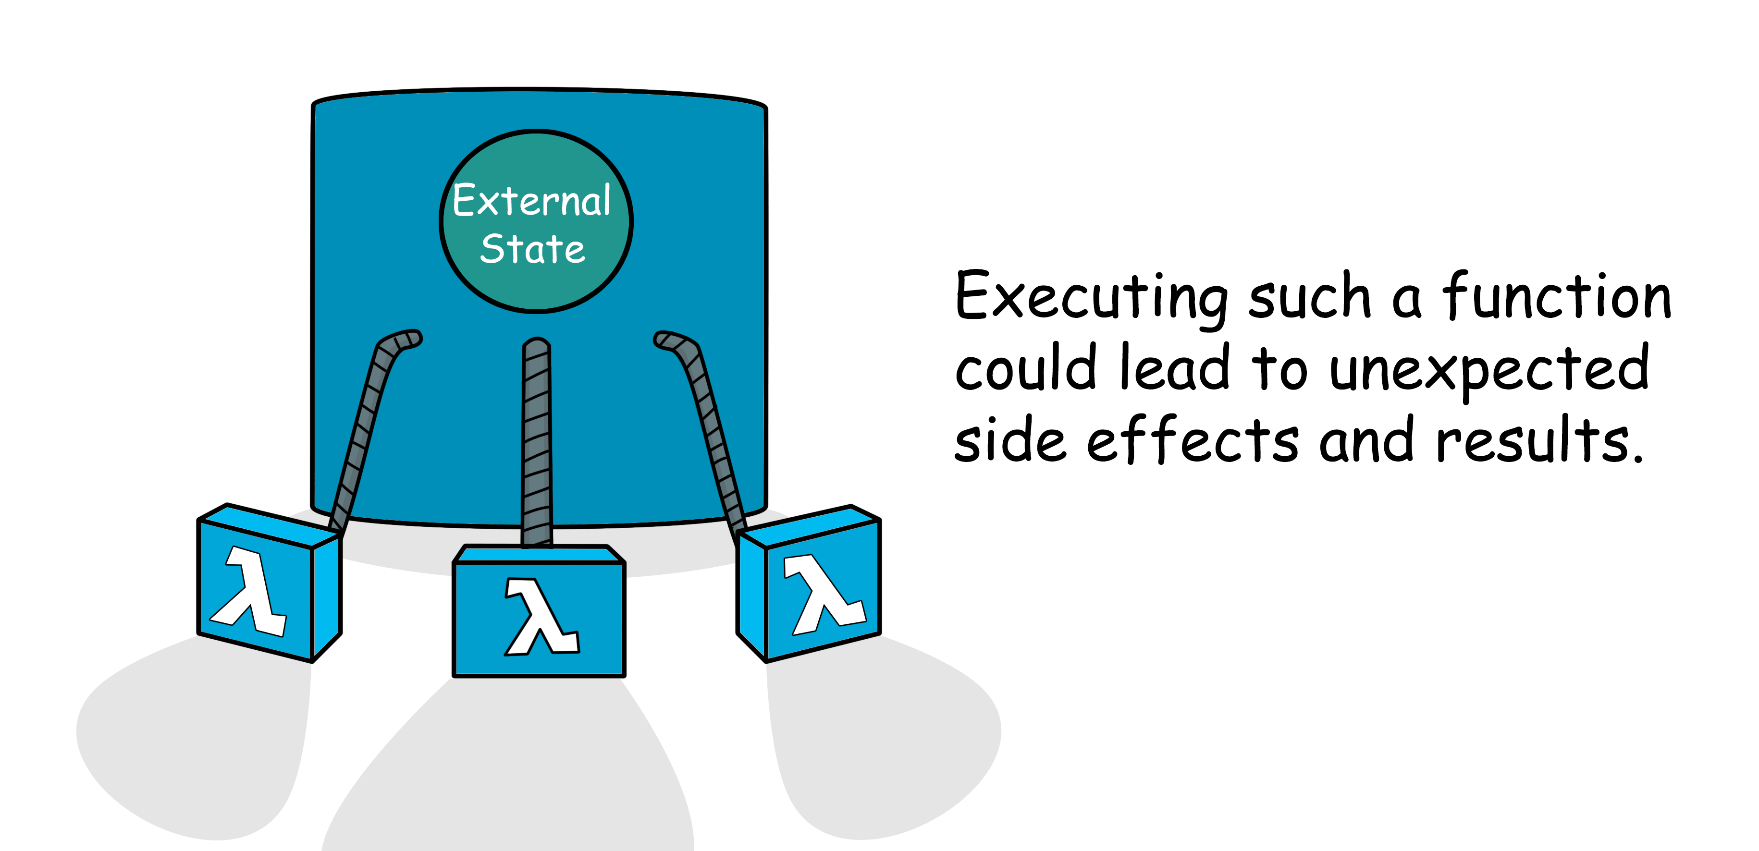
Pure
Impure

Slide 35
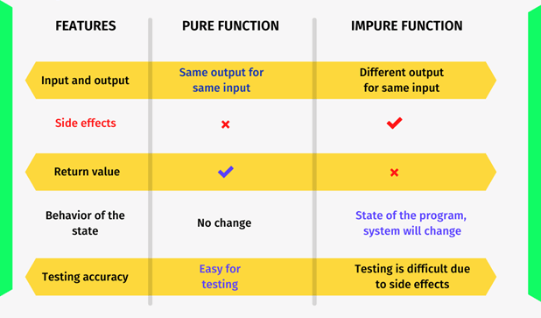
Pure vs impure function

Slide 36
Pure function manifesto
Function always returns a value.
Function always returns just one value of the same type.
Function calculates the return value based only on the arguments.
Function doesn't mutate arguments.
For the same inputs it must returns the same outputs.
Pure function’s existence in programming is inspired by mathematical functions, which are always pure.

Slide 37
Pure functions
/** * Format du nom d'une dépendance à une artifact maven * @param {string} dependencyGroupId * @param {string} dependencyName * @return {string} */ const normalizeDependencyName = (dependencyGroupId, dependencyName) => `${dependencyGroupId}:${dependencyName}`; /** * Normalisation des stats * @param {Array} series * @return {*} */ const normalizeBackendSeries = (series) => series.filter((item) => item && item.y && item.y > 0);
/** * Identification du groupe id par défaut * @param {Array} pomContent * @return {*} */ const findDefaultGroupId = ({ pomContent, }) => pomContent.findIndex((tag) => ( tag.includes(`<groupId>`) && tag.includes('awt') && tag.includes(`</groupId>`) ));
/** * Identification du groupe id à partir de l'artifact id * @param {string} awtTrigramme * @param {Array} pomContent * @return {*} */ const findGroupIdByArtifactId = ({ awtTrigramme, pomContent, }) => pomContent.findIndex((tag) => ( tag.includes(`<artifactId>`) && tag.includes(awtTrigramme.toLowerCase()) && tag.includes(`</artifactId>`) ));

Slide 38

what do we gain from having pure functions?

Slide 39
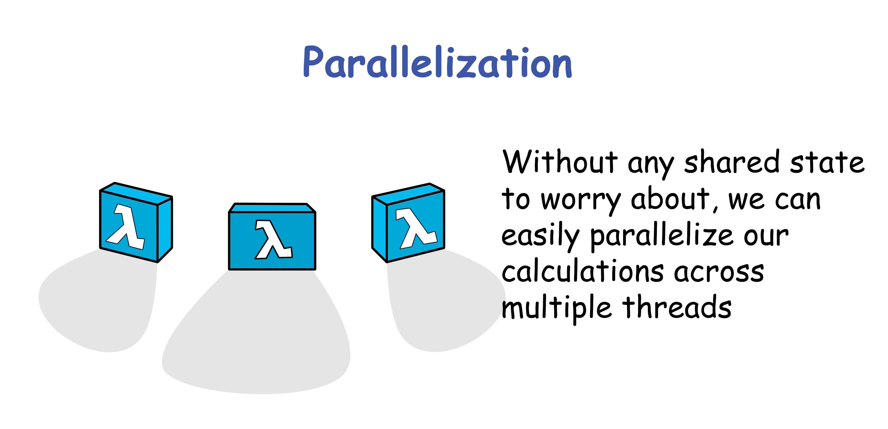

Slide 40
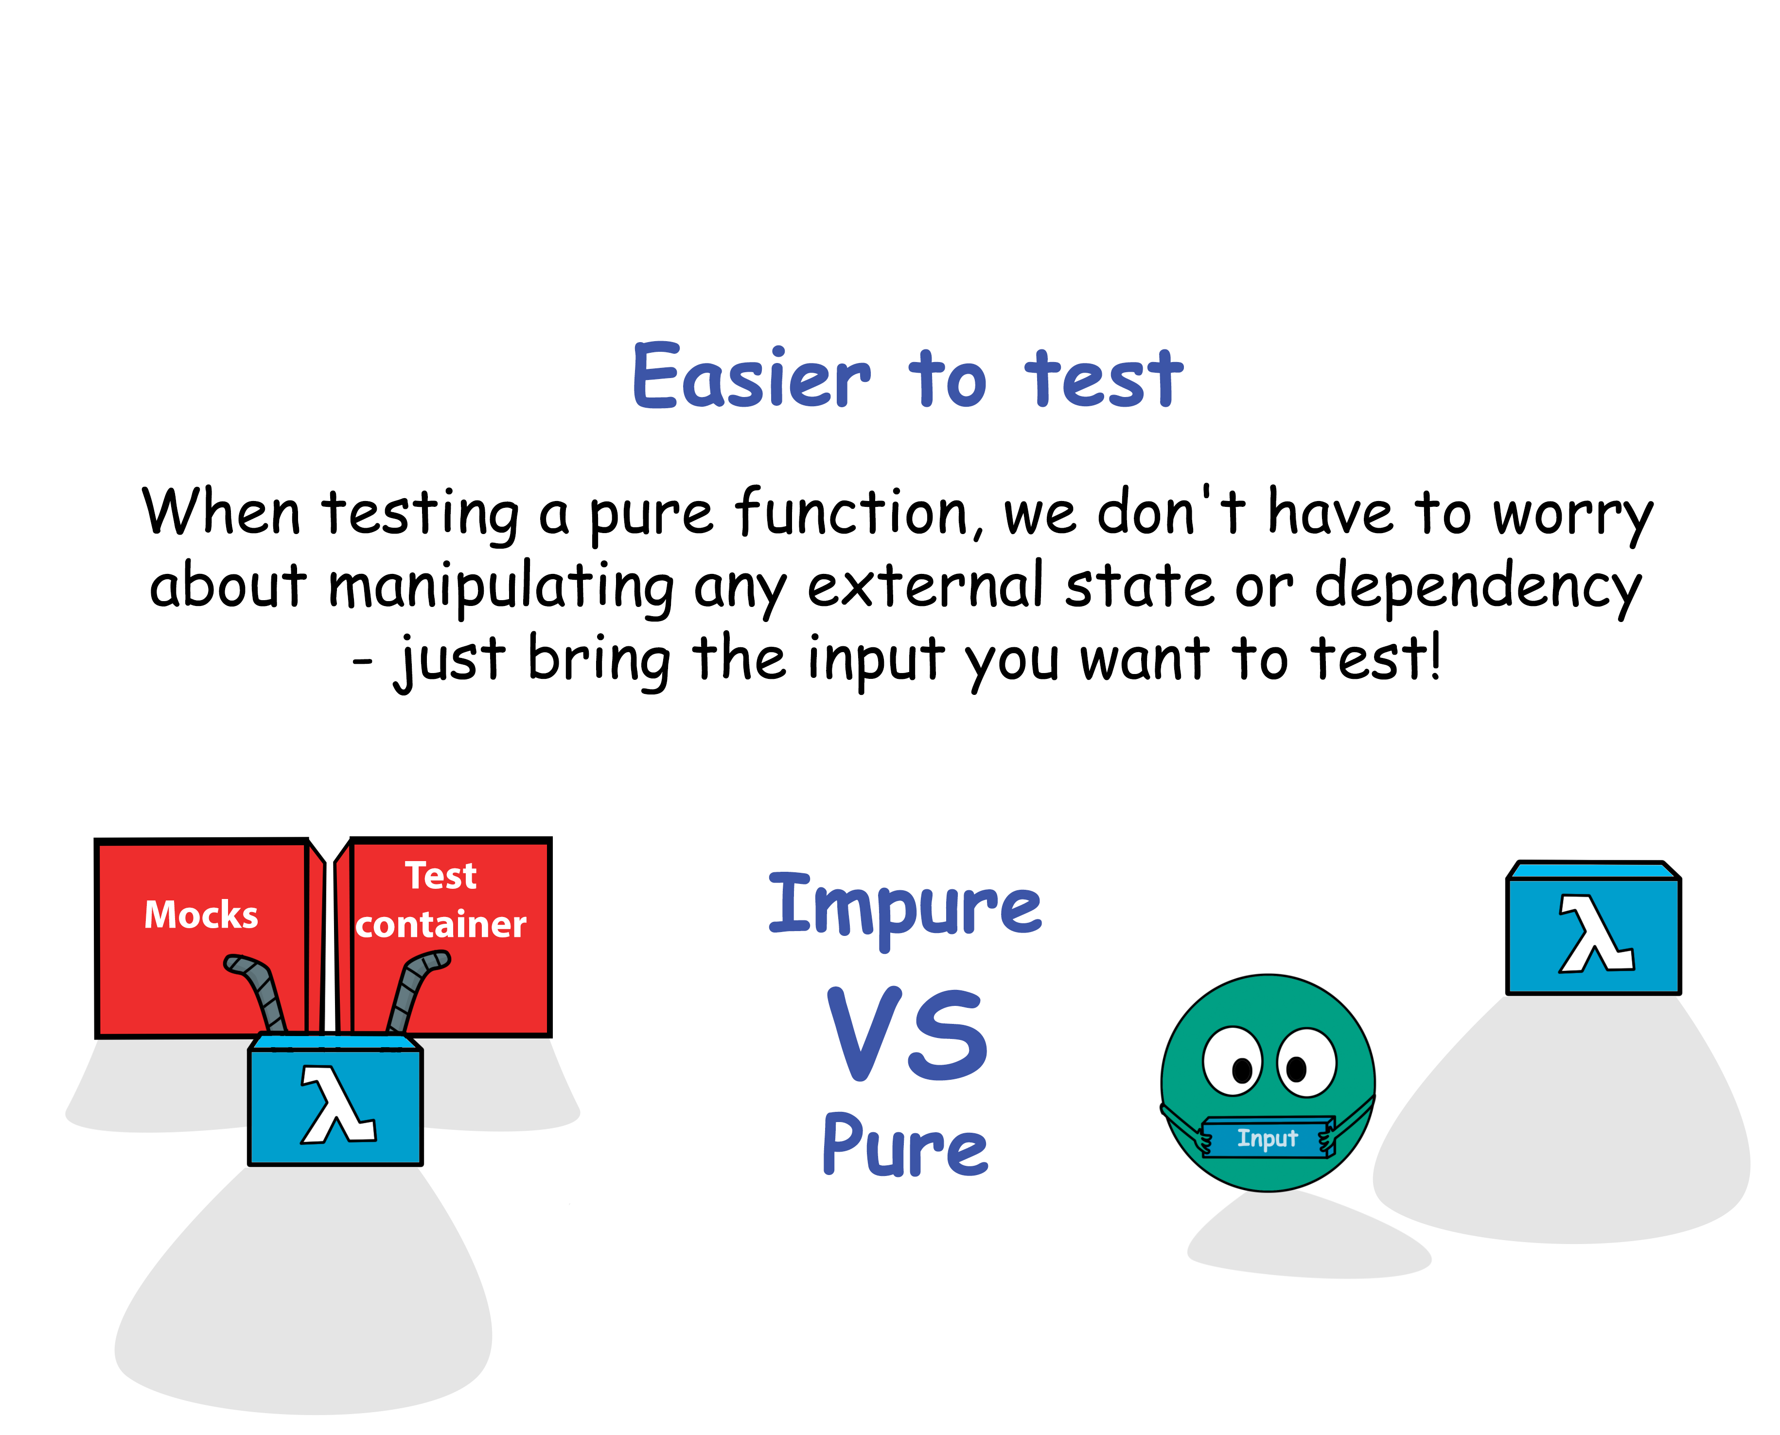

Slide 41
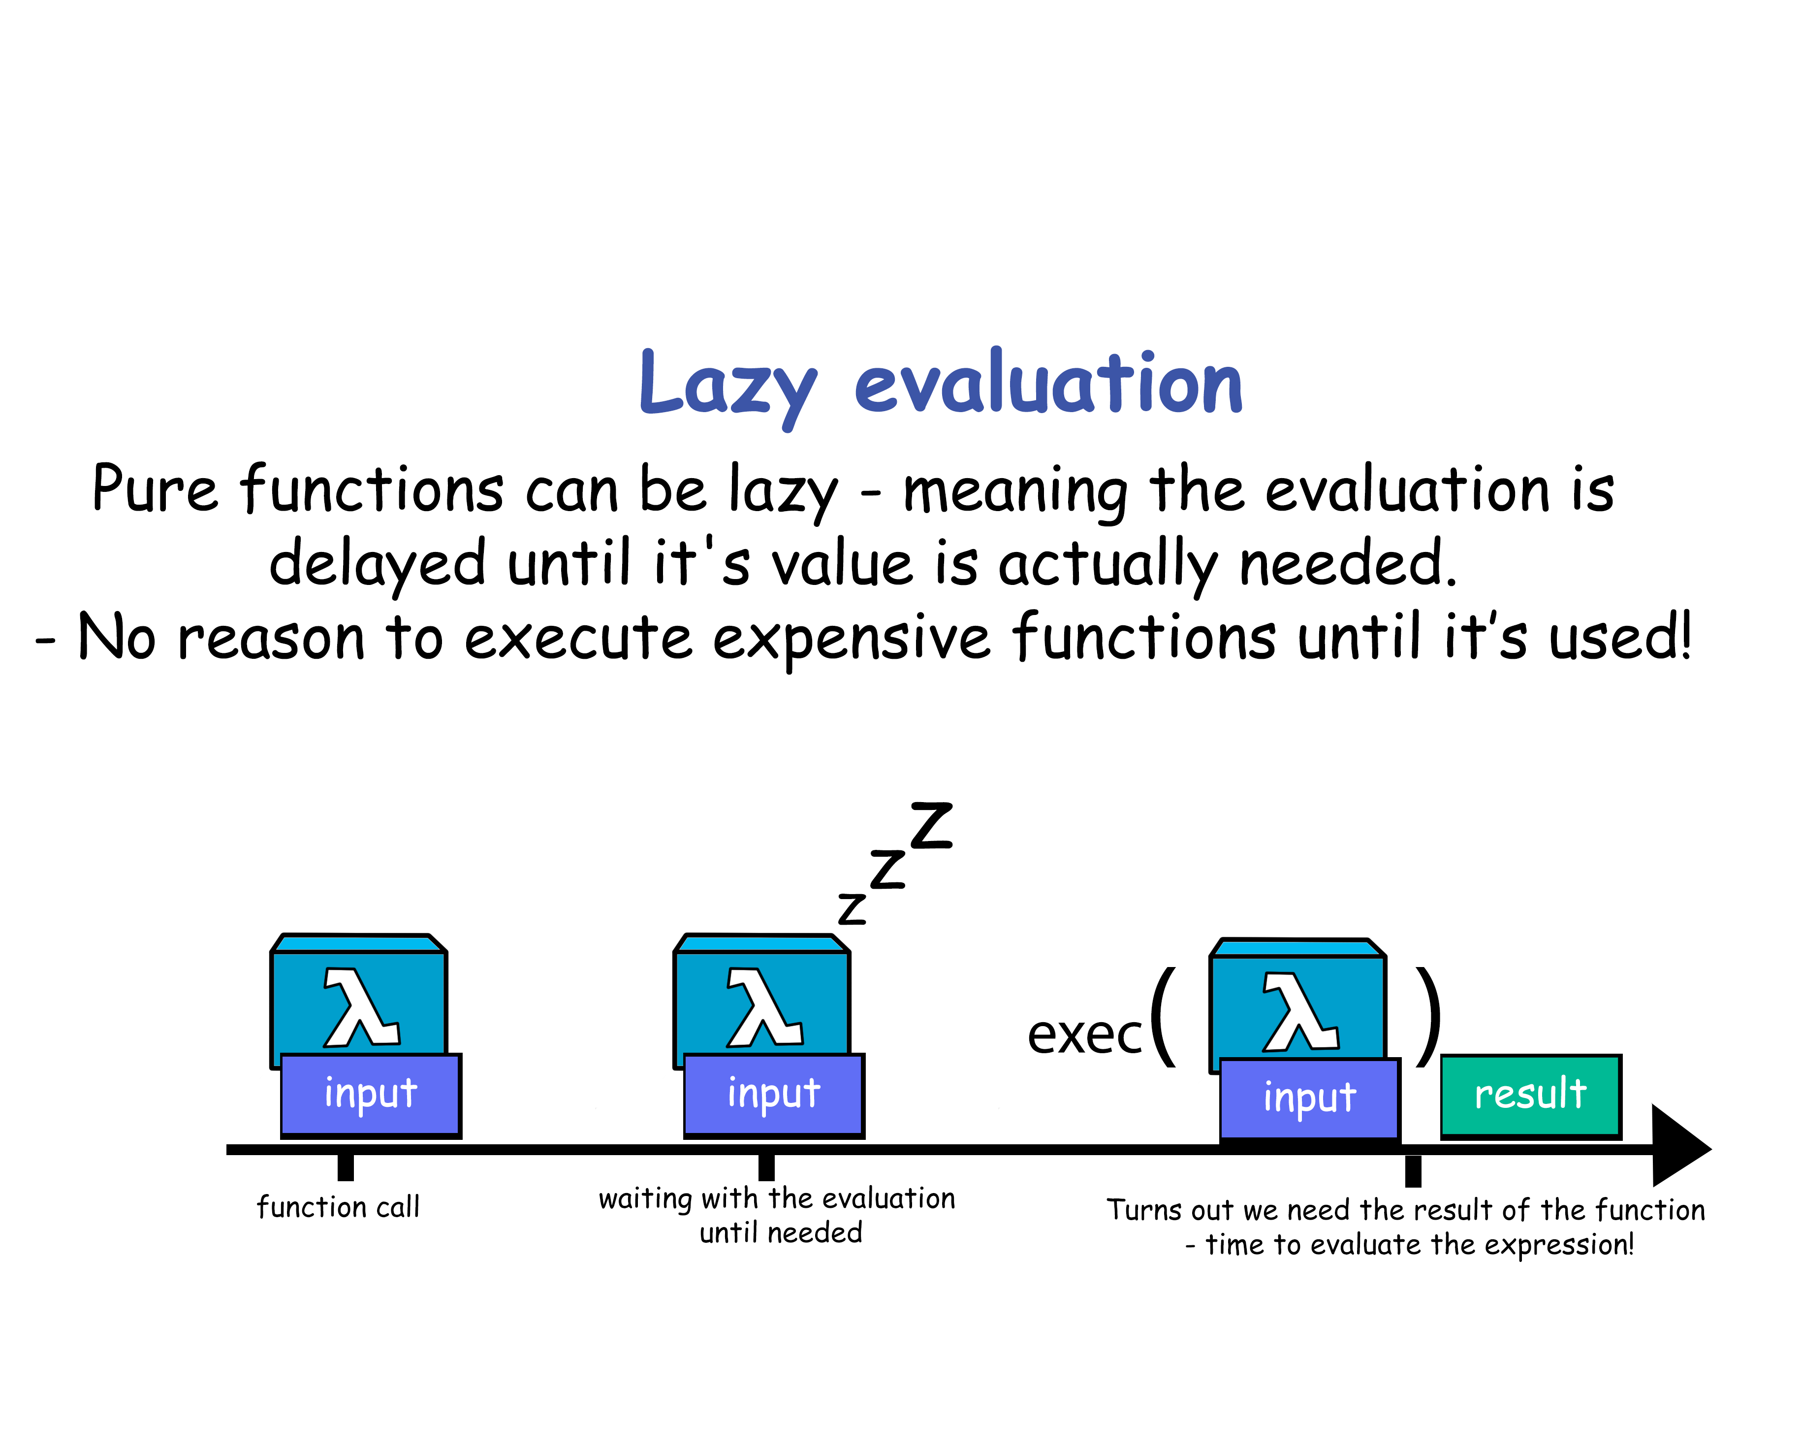

Slide 42
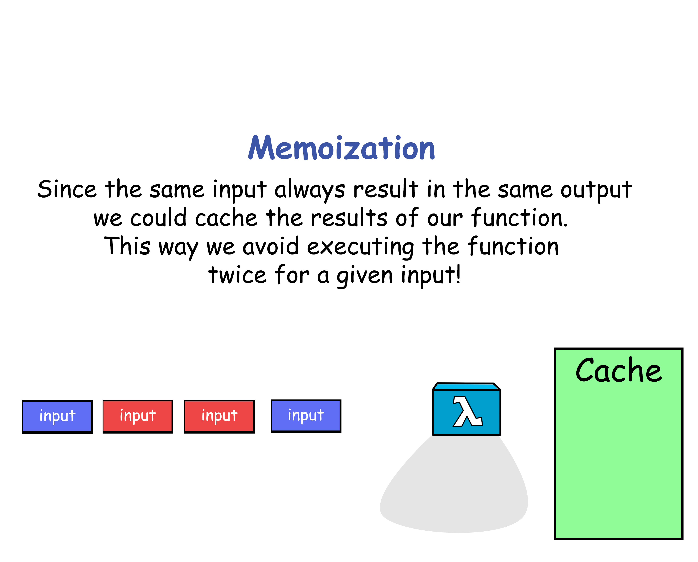

Slide 43
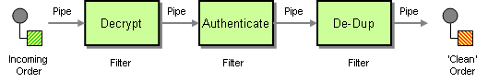
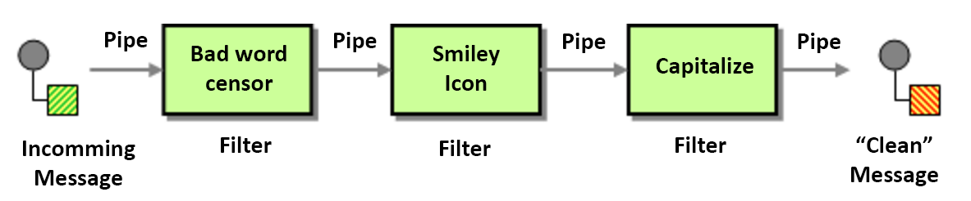
pure program
A pure program is a pipeline of pure functions.

Slide 44
pure program
/** * Transforme les données retournées par : https://sgithub.fr.world.socgen/SocleDigitalClient/sg_web_dgt_access-rights/blob/master/config/apps-list.json * dans le format attendu par le frontend * @param {Array} trigrammes * @param {number} start * @param {number} end * @return {*[]|*} */ const formatTrigrammes = ({ trigrammes, start, end, }) => { if (!trigrammes || !trigrammes.length) return [];
return trigrammes .slice(start || 0, end || trigrammes.length)
.map((item) => ({ trigram: item.trigram, description: item.name, detail: item.detail, }))
.filter((trigramme) => isValidTrigramme(trigramme))
.sort(( a, b ) => { if ( a.trigram < b.trigram) { return -1; } if ( a.trigram > b.trigram ) { return 1; } return 0; }); };
1
/** * Permet de valider le trigramme d'une application * @param {object} trigramme * @return {boolean} */ const isValidTrigramme = (trigramme) => ( trigramme && !trigramme.trigram.includes('XBL') && !trigramme.trigram.includes('AWT') && !trigramme.trigram.includes('XBT') && !trigramme.trigram.includes('SGC') && !trigramme.trigram.includes('ICD') && !trigramme.trigram.includes('DGT') && !trigramme.trigram.includes('ECOSYSTEME_ARCHI') && !trigramme.trigram.includes('ECOSYSTEME_BAD') && !trigramme.detail.includes('_FAKE_') && !trigramme.detail.includes('_PRODUCT_') || false );
2
A pure program is a pipeline of pure functions.
3
4

Slide 45
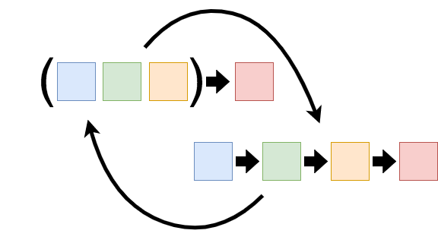
pure program
A pure program is a composition of pure functions.

Slide 46
Pure program
const frontend = buildFrontend({ repoOwner, repoName, repoGitBranch: repoAnalyzedGitBranch, options, }); const backend = buildBackend({ repoOwner, repoName, repoGitBranch: repoAnalyzedGitBranch, repoGithubWebUrl, options, }); const dependencies = [ ...(frontend?.dependencies || []), ...(backend?.dependencies || []), ]; const modulesKeywords = [ ...(frontend?.keywords || []), ...(backend?.keywords || []), ];
const frontendEvolutions = formatFrontendEvolutions({ keywords, qualityGates, });
const backendEvolutions = formatBackendEvolutions({ keywords, qualityGates, });
const commonsEvolutions = formatCommonsEvolutions({ keywords, qualityGates, });
const evolutions = [ ...(frontendEvolutions || []), ...(backendEvolutions || []), ...(commonsEvolutions || []), ];
/** * Format des données de stats * @param {string} type * @param {object} stats * @return {Array} */ const formatStatsSeries = (type, stats) =>{ const frontendStats = formatFrontendStatsSeries(type, stats); const backendStats = formatBackendSeries(type, stats); return ([ ...(frontendStats || []), ...(backendStats || []), ]); };
A pure program is a composition of pure functions.

Slide 47
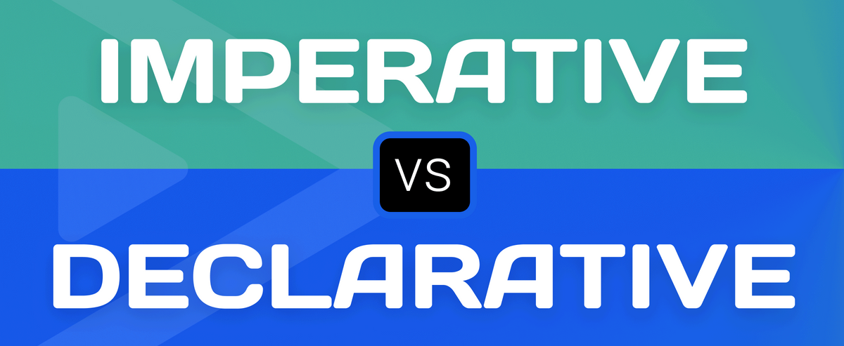

Slide 48
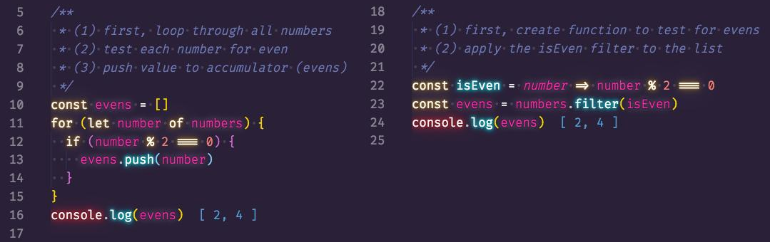
Imperative vs Declarative style
Imperative
Declarative

Slide 49
Declarative style
« What » is more important than « How » :
const double1 = (array) => { for(let i=0; i<array.length; i++){ array[i] = array[i] * 2; } return array; }
What to do ?
How to do ?
const double2 = (array) => array.map(item => item * 2);
Reduces the structure of a function down to the most important pieces (a formula)

Slide 50
Arrow function vs regular function
function length(value) { return value ? value.length : 0; }
const length = (value) => (value ? value.length : 0);
Function name
params
Expression : what function will do ?
arrow

Slide 51
Arrow function
const decodeUrlParams = (param) => { if (param) { try { return decodeURIComponent(param); } catch (e) { return param; } } return null; };
const length = (value) => (value ? value.length : 0);
Multiple lines
Implicit return
Explicit return

Slide 52
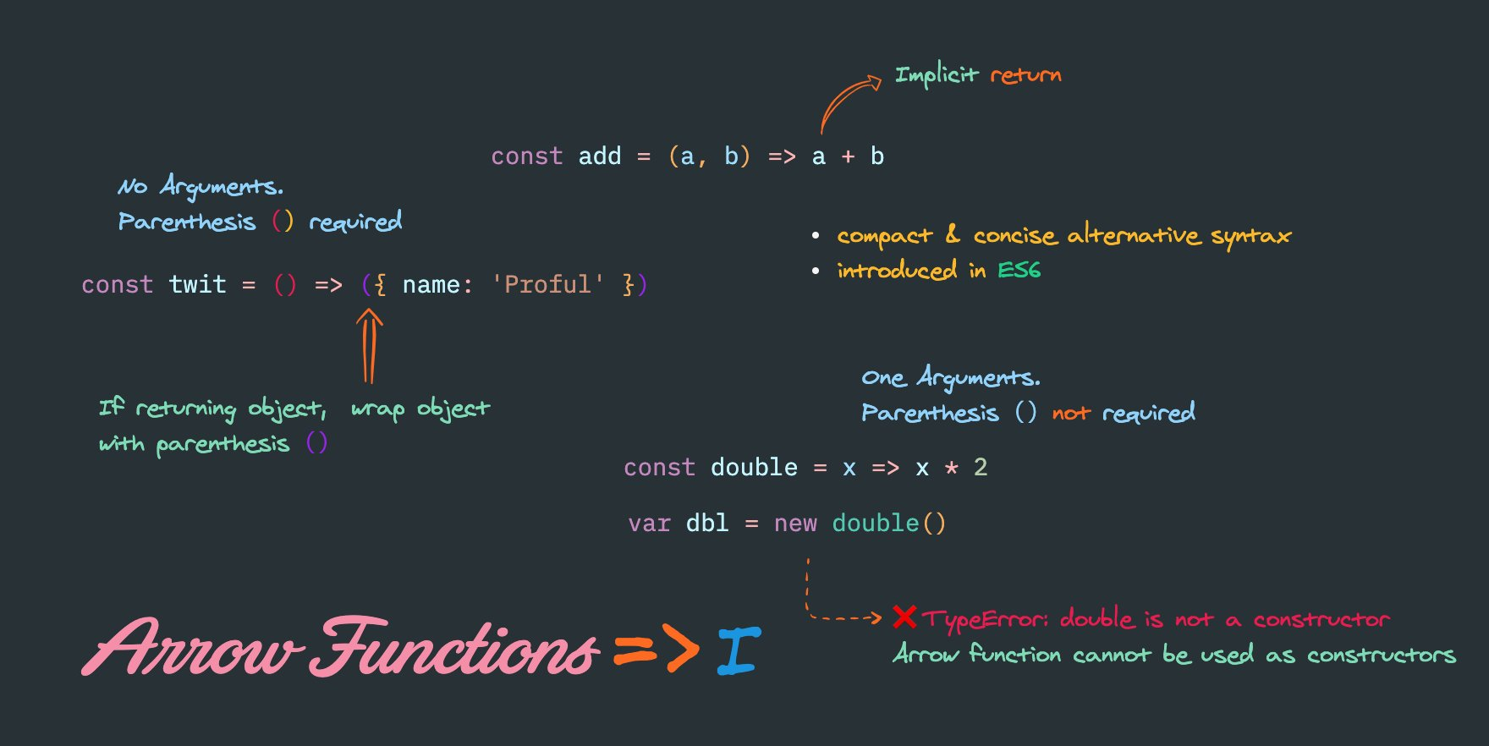

Slide 53
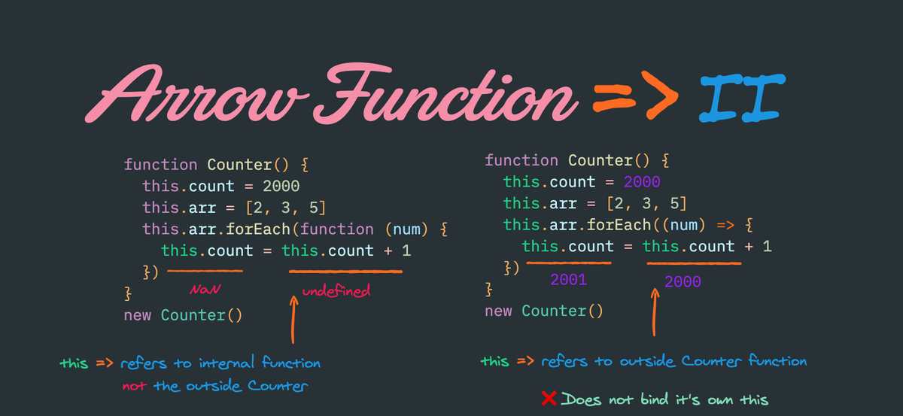

Slide 54

Mutable vs immutable

Slide 55
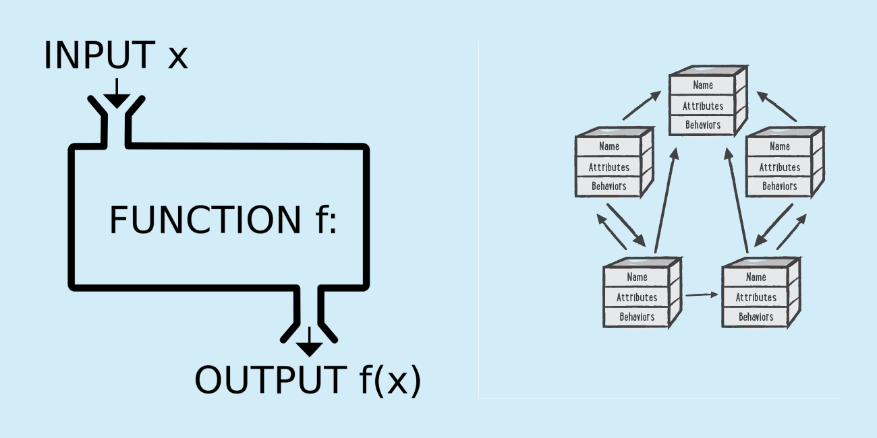
Functional programming
Functional programming allows transformation (immutability) and prohibits mutation (mutability).

Slide 56
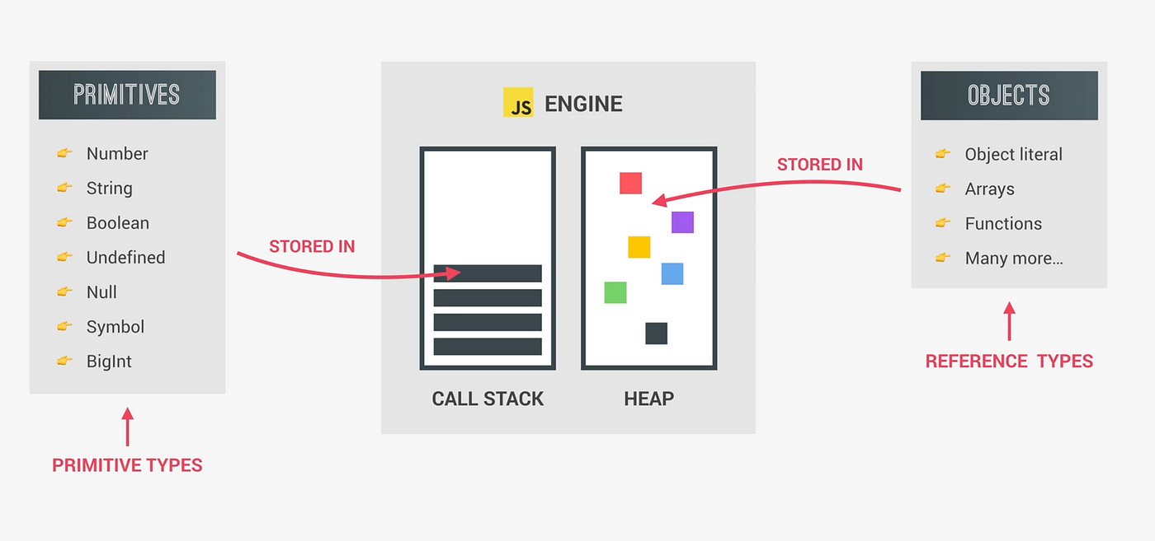
Shallow vs deep copy

Slide 57
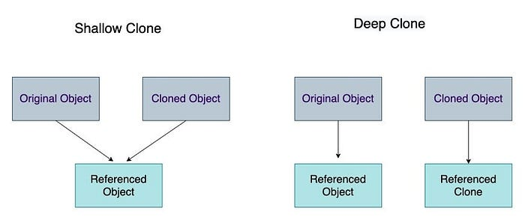
Shallow vs deep copy

Slide 58
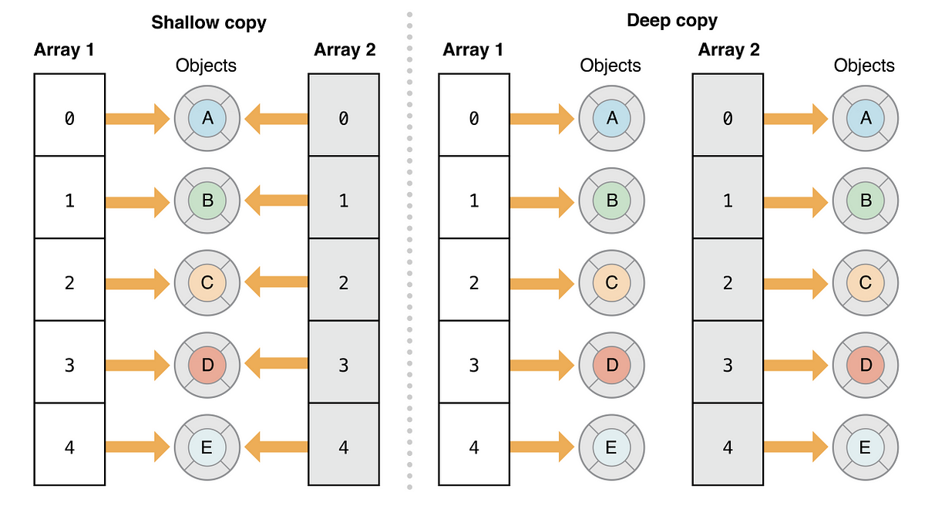
Shallow vs deep copy

Slide 59
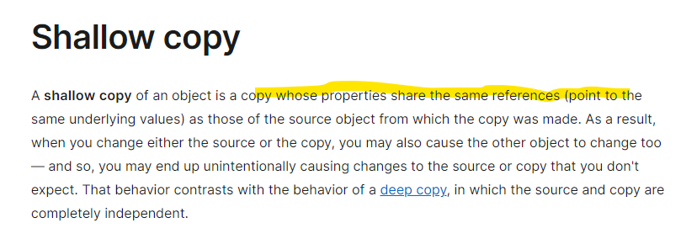
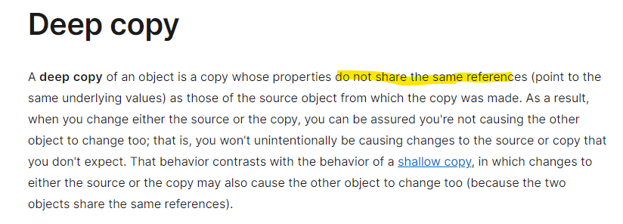
Shallow vs deep copy

Slide 60
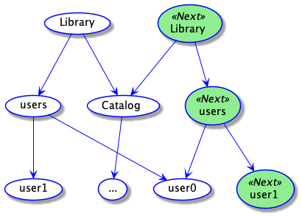
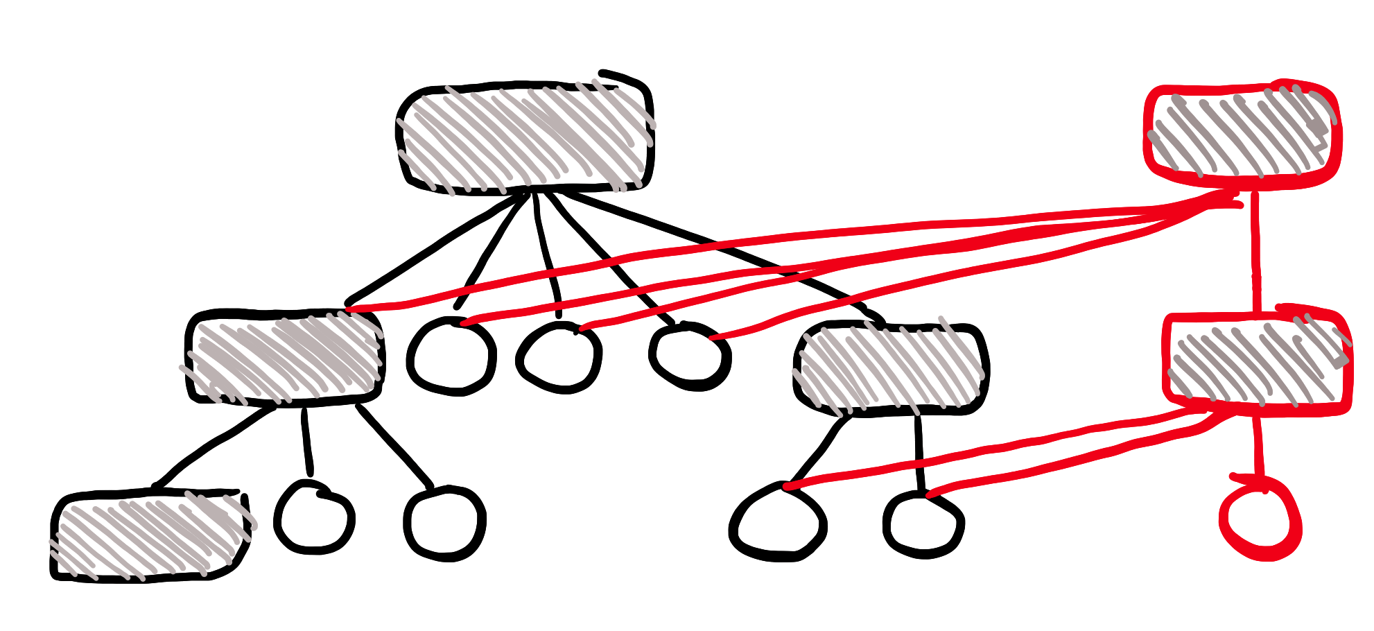

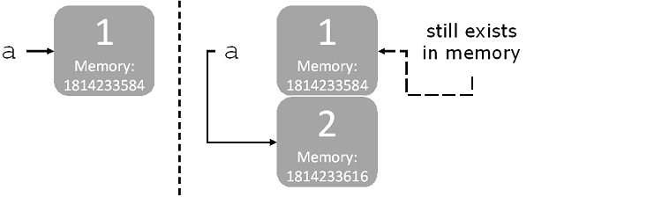
structural sharing

Slide 61
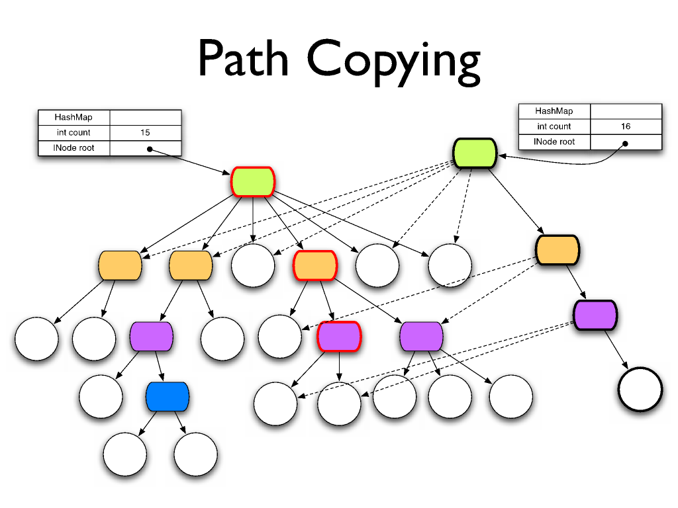
structural sharing

Slide 62
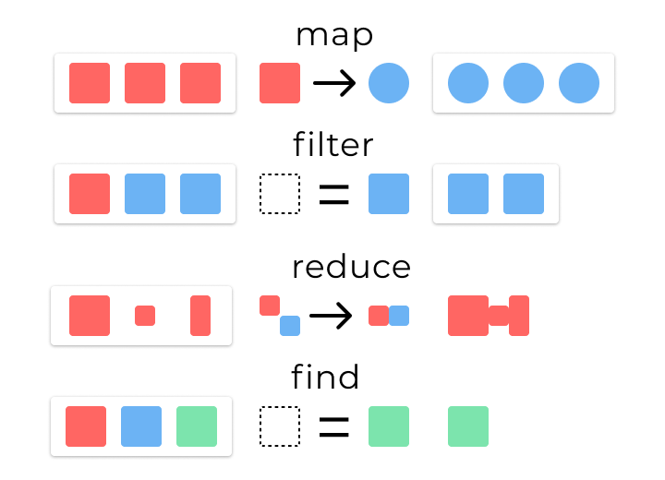
Map/filter/reduce (shallow copy)

Slide 63
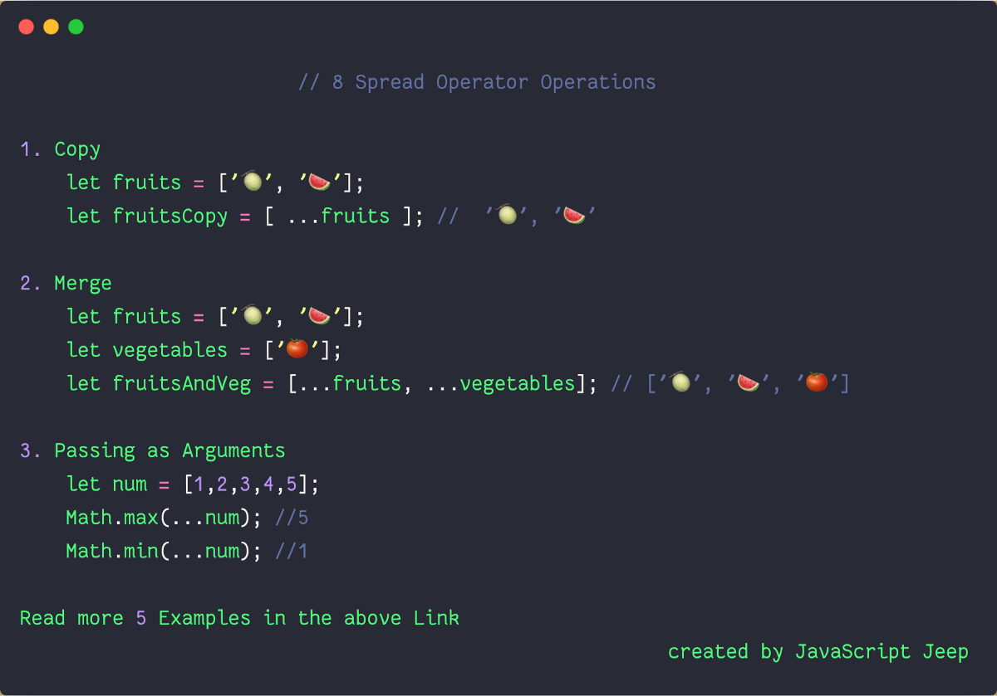
Spread (shallow copy)

Slide 64

recommendation
Deep clone isn’t recommended for performance (speed and memory) issues.

Slide 65
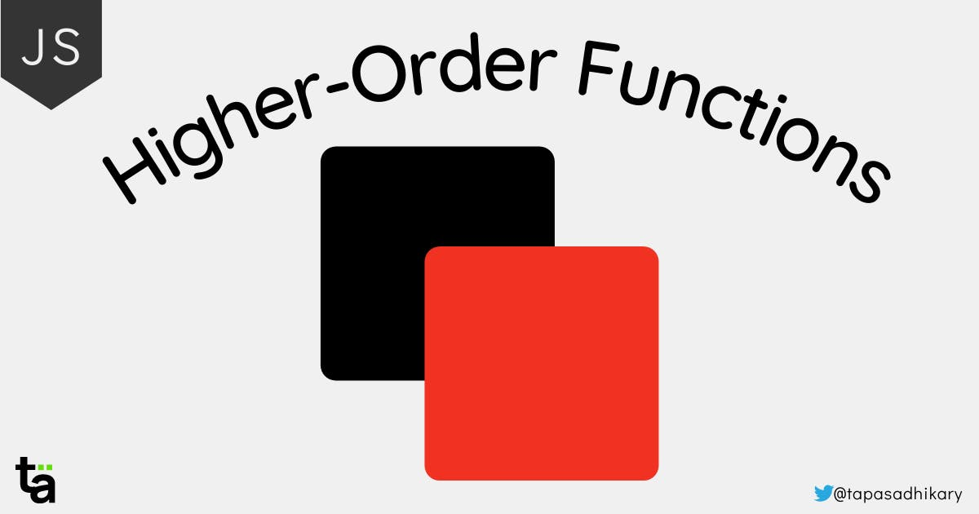

Slide 66
High Order Functions (definition)
Functions that operate on other functions, either by taking them as arguments or by returning them, are called higher-order functions.
— Eloquent JavaScript

Slide 67
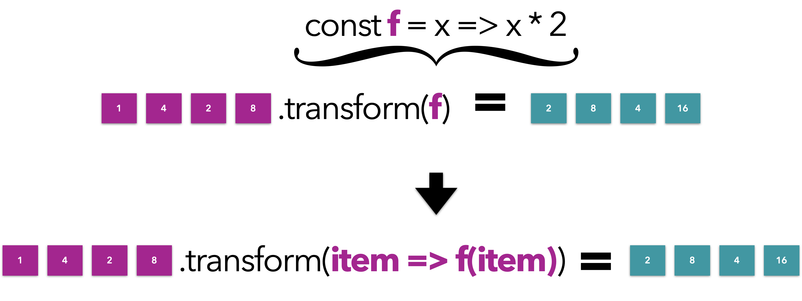
High order function

Slide 68
High order function
const transform = (array, f) => { const arrayCopy = [ ...array || [], ];
/////////// if (arrayCopy && arrayCopy.length && f) { for (let i = 0; i < arrayCopy.length; i++) { arrayCopy[i] = f(arrayCopy[i]); } } return arrayCopy; }
const data = [1, 4, 2, 8]; const double = x => x * 2; const plusOne = x => x + 1;
console.log('double array : ', transform(data, double)); console.log('plus one array : ', transform(data, plusOne));
f => double / plusOne

Slide 69
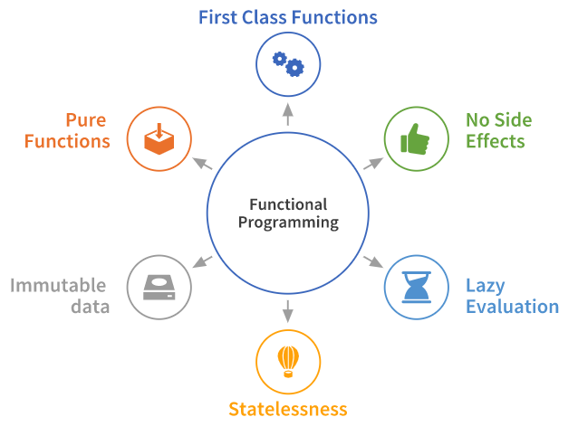
Let’s sum up

Slide 70

Benefits of Functional Programming
Predictability, determinism, and isolation are the code qualities needed to have good unit tests !

Slide 71

a bit of practice

Slide 72
High order function in js
map
filter
every
some
sort
reduce

Slide 73
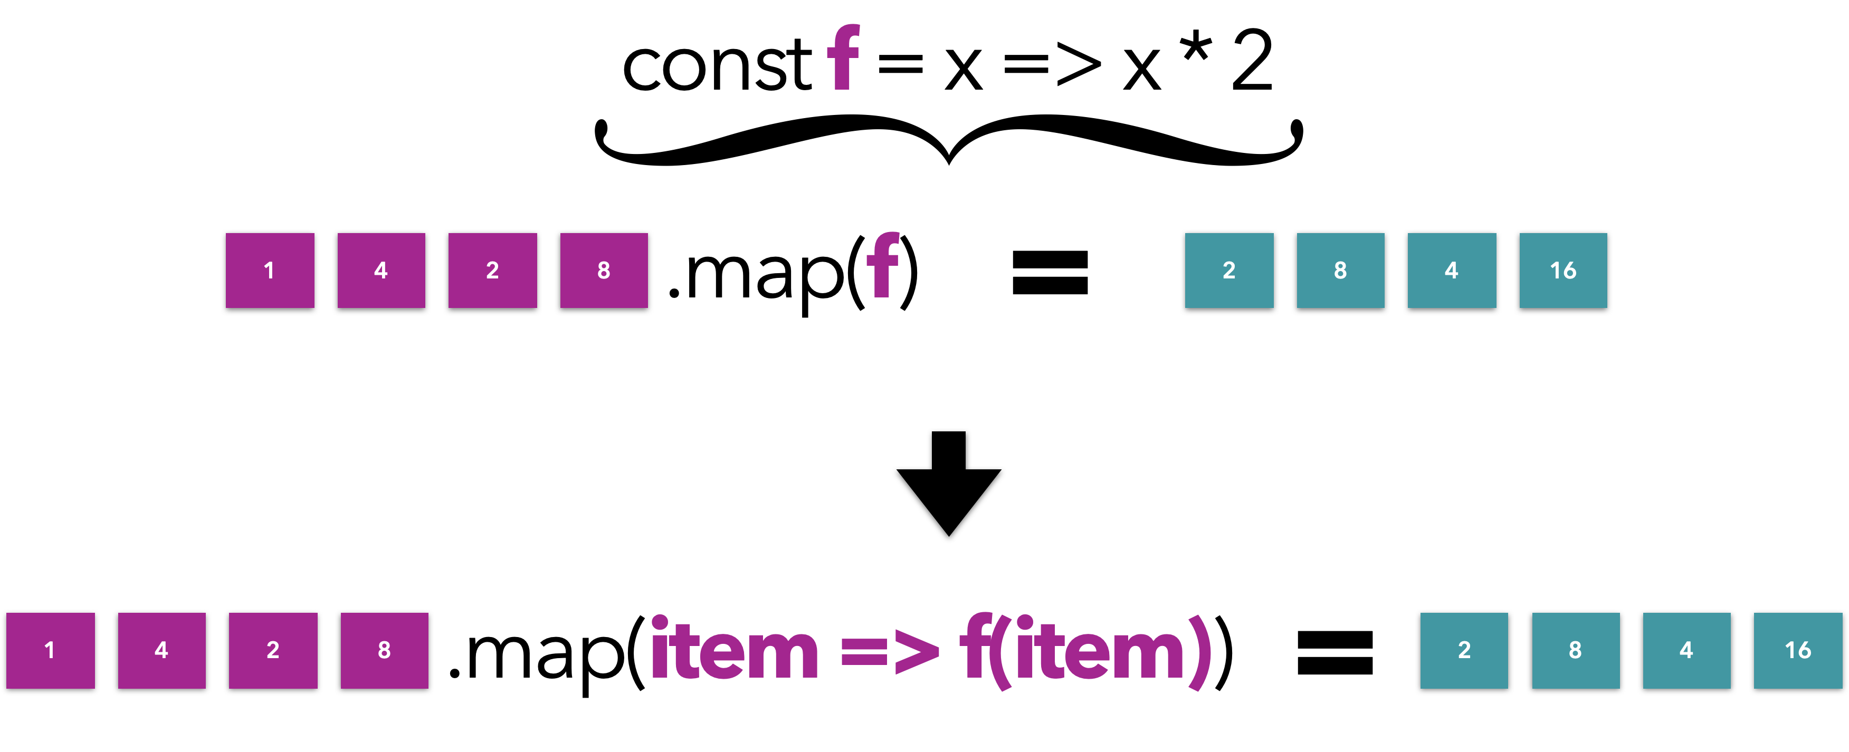
map

Slide 74
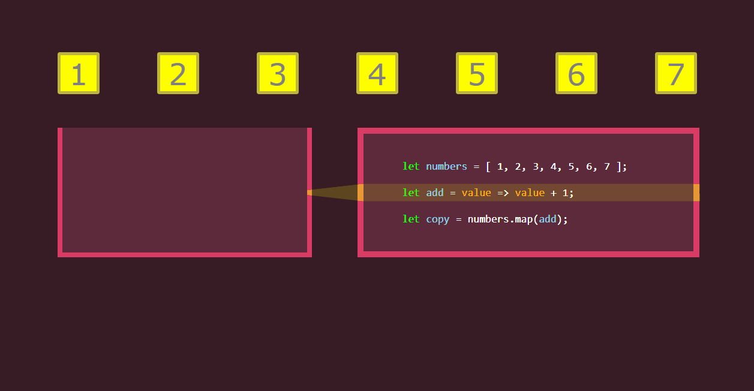
Map

Slide 75
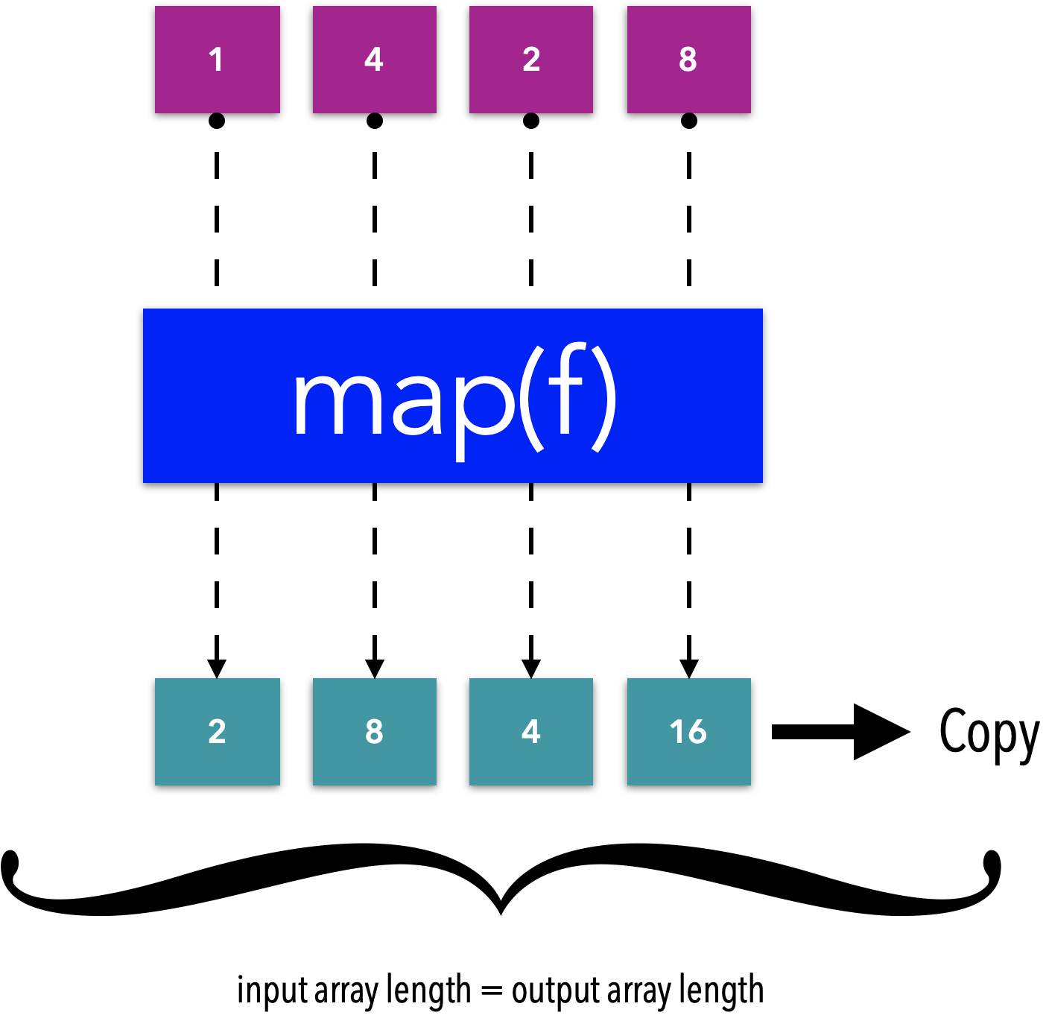
Map

Slide 76
map (example)
const sequence = [1, 2, 3, 4, 5]; const doubleSequence = sequence.map((item) => item * 2); // [2,4,6,8,10]

Slide 77
JS Array & Object are Reference Type
let array1 = [1,2,3] let array2 = array1 array2[1] = 25 // => this line affects both tables (1 and 2)
array1 = [1, 25, 3] array2 = [1, 25, 3]
Heap
const person = { name:'John', lastName:'Smith', age:20 }; const newPerson = person; person.age=50;// this lines affects both objects const person = { name:'John', lastName:'Smith', age:50, }; const newPerson = { name:'John', lastName:'Smith', age:50, };
[1, 2, 3 ]
Array 1
Array 2

Slide 78
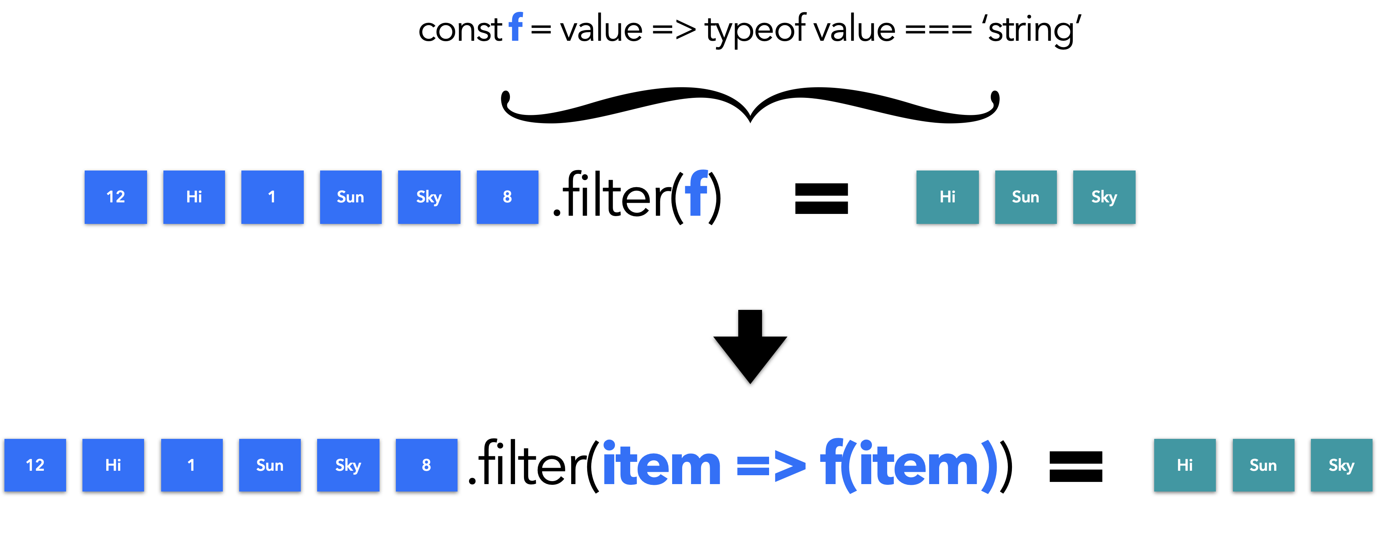
filter

Slide 79
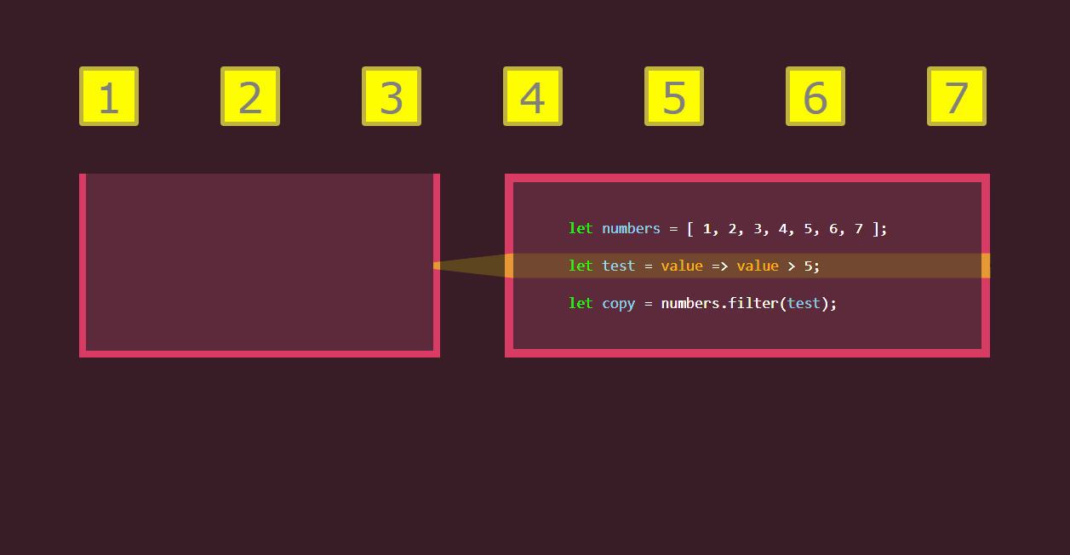
Filter

Slide 80
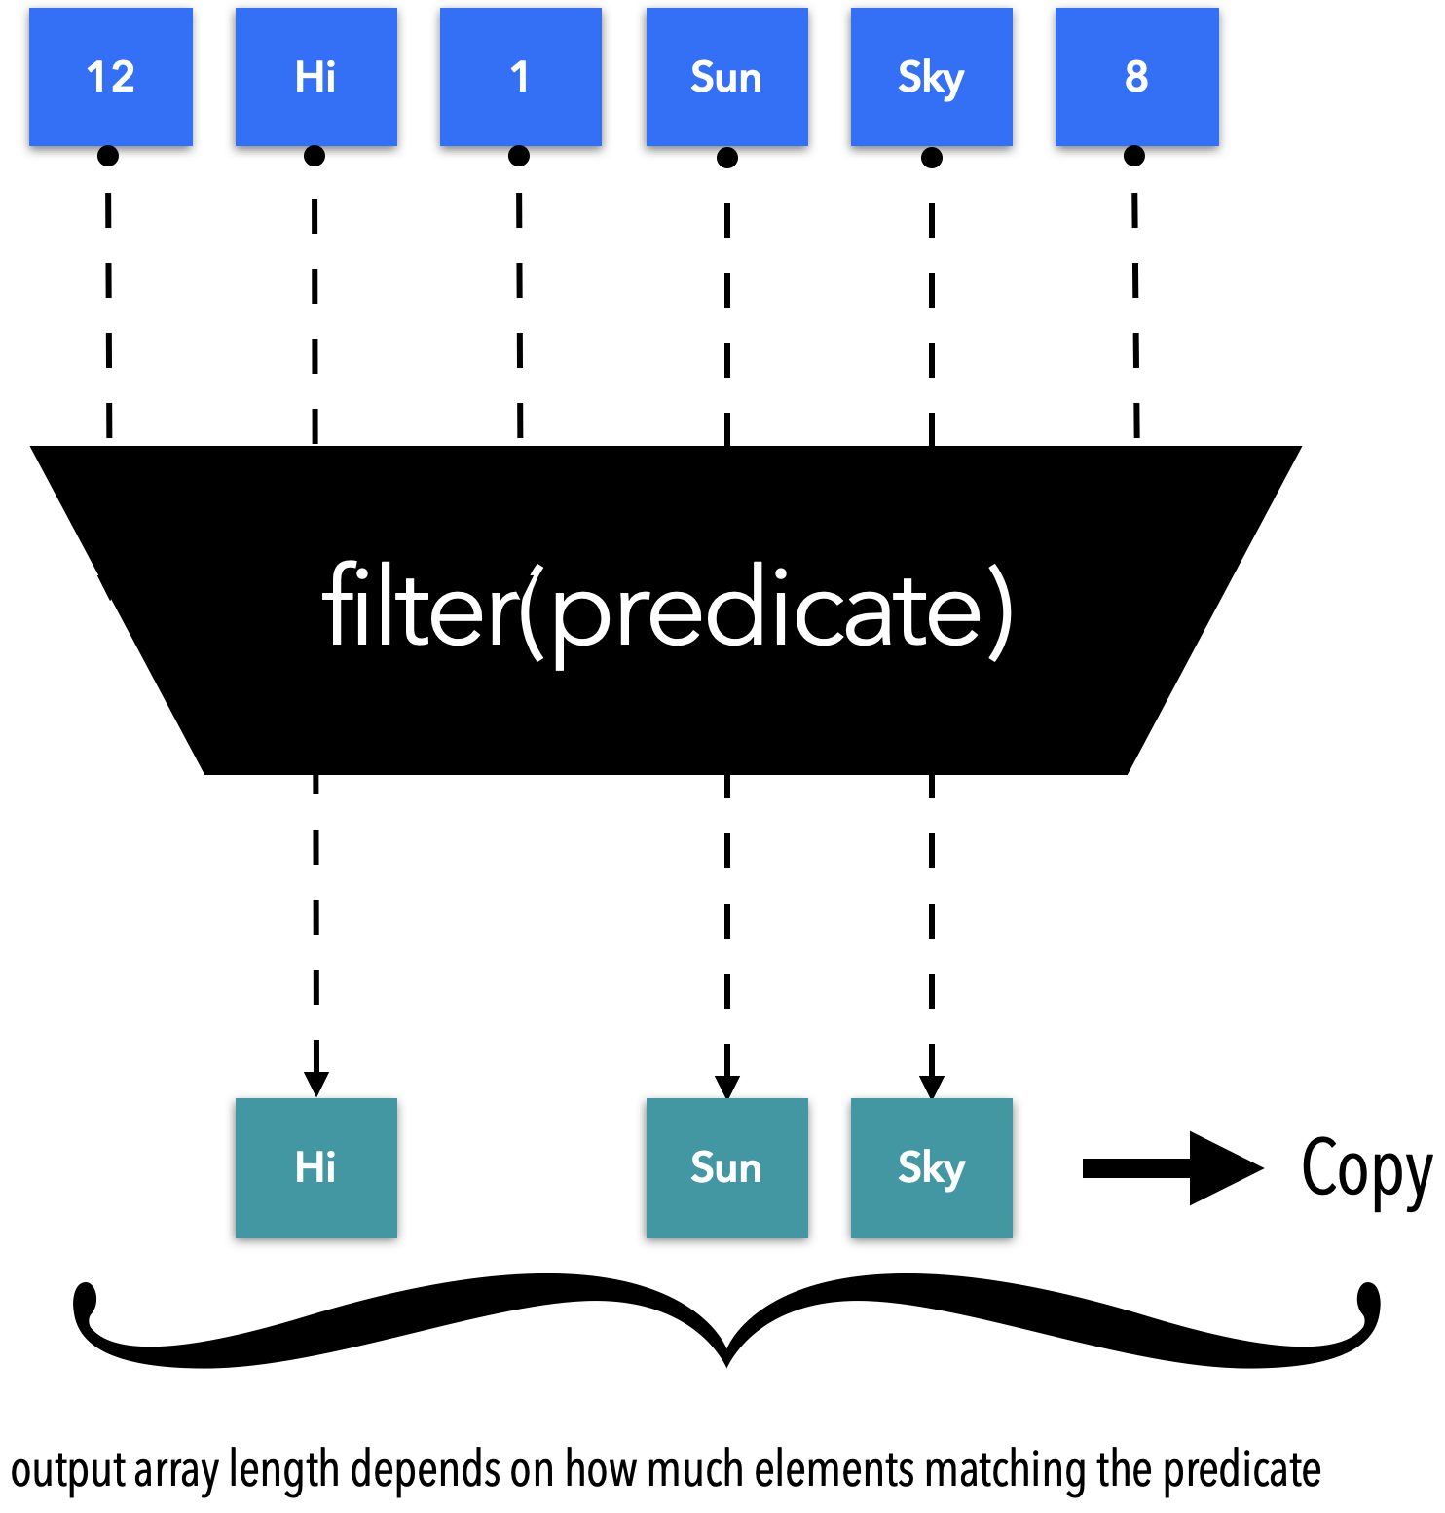
Filter

Slide 81
Filter (example)
const values = [12, 'Hi', 1, 'Sun', 'Sky', 8]; const valuesMatched = values.filter(value => typeof value === 'string'); console.log('valuesMatched : ', valuesMatched); // "valuesMatched : ", ["Hi", "Sun", "Sky"]

Slide 82
Every
[12, 5, 8, 130, 44].every(elem => elem >= 10); // false
[12, 54, 18, 130, 44].every(elem => elem >= 10); // true
[{a:1, b:2}, {a:1, b:3}].every(elem => elem.a === 1); // true
[{a:2, b:2}, {a:1, b:3}].every(elem => elem.a === 1); // false
every tests whether all the elements of an array satisfy a condition

Slide 83
Some
[2, 5, 8, 1, 4].some(elem => elem > 10); // false [12, 5, 8, 1, 4].some(elem => elem > 10); // true (12)
some tests if at least one element of the array passes a condition

Slide 84
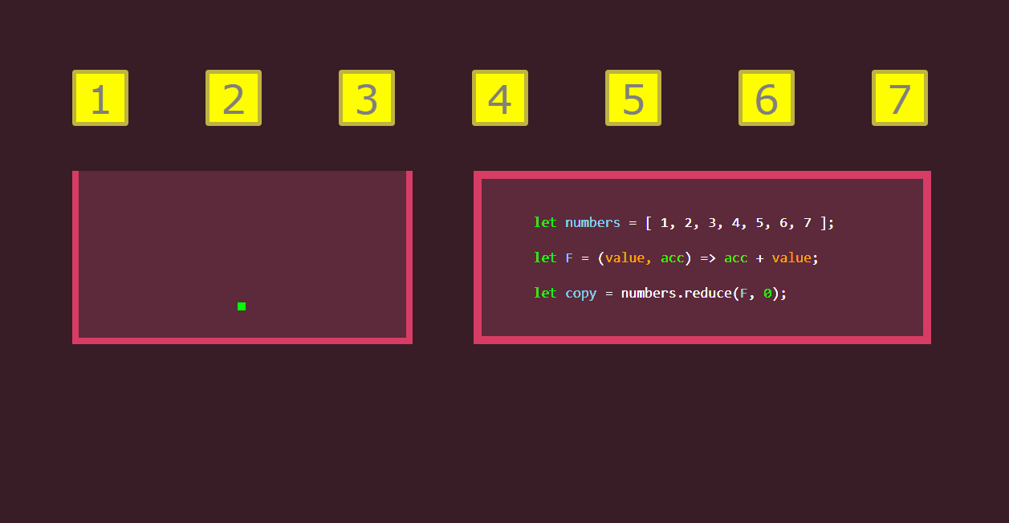
Reduce

Slide 85
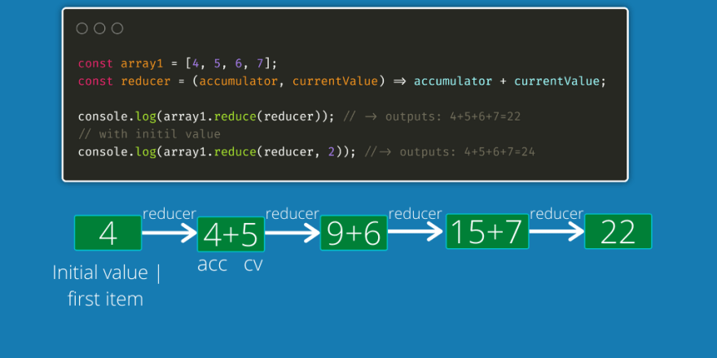
Reduce

Slide 86
Reduce (example)
const authors = ['Lewis', 'Wilson', 'Verne', 'Tolstoy', 'Twain', ]; const result = authors.reduce((prev, current) => `${prev}, ${current}`); console.log(result); // "Lewis, Wilson, Verne, Tolstoy, Twain"

Slide 87


Reduce (tips)
Array => Object (group by)
Flat array

Slide 88
Map filter find reduce

Slide 89

chaining
Respect Arity and Type

Slide 90
Chaining (example)
const complexArray = [6, 2, 4, 8, ] .map(x => x * 2) .map(x => x + 1) .filter(x => x > 10); console.log('complexArray : ', complexArray); // "complexArray : ", [13, 17]

Slide 91

chaining
Respect Arity and type

Slide 92

chaining
We can’t chain after reduce

Slide 93
Practice : array transformation functions
https://sgithub.fr.world.socgen/AppliDigitalClient/ref_awt_gfm_documentation_wiki/raw/master/docs/files/formations-socle-frontend-react/2022/01-Modern_Javascript_exercice_cartes.js

Slide 94
Spread (Array)
const tab3 = […tab1, …tab2]
Right side of «=»
Spread: decompose an array into elements
// combine/concat arrays const tab1 = [1, 2, 3, 4, 5]
const tab2 = [7, 8, 9, 10, 11]
const tab3 = [...tab1, ...tab2]
// [ 1, 2, 3, 4, 5, 7, 8, 9, 10, 11 ] : like arr3.concat(arr1, arr2)
https://developer.mozilla.org/en-US/docs/Web/JavaScript/Reference/Operators/Spread_syntax#syntax
https://react.dev/learn/updating-arrays-in-state

Slide 95
Spread (Object)
// Object Concat // the spread operator can be used // to shallow copy the properties // from one or more objects into another object. const obj1 = { a: 1, b: 2, c: 3, }
const obj2 = { p: 4, q: 5, r: 6, }
const obj3 = { ...obj1, ...obj2, } console.log('obj3 : ', obj3) // { a: 1, b: 2, c: 3, p: 4, q: 5, r: 6 }
Object.assign({}, obj)
Merge obj1 and obj2 => obj3 is a shallow copy
https://developer.mozilla.org/en-US/docs/Web/JavaScript/Reference/Operators/Spread_syntax#syntax

Slide 96
Spread (Object)
// original state const state = { isFavorite: true, isWishList: true, };
1/ spread original => copy
2/ change specified attribute value
3/ add the new attribute
Transform
Transform & extends
const newState = { ...state, isFavorite: false, };
const newExtendState = { ...state, isFavorite: false, isLogged: false, };
1/ spread original => copy
2/ change specified attribute value
// newState : { isFavorite: false, isWishList: true } : transform only isFavorite
// newExtendState : { isFavorite: false, isWishList: true, isLogged: false }
https://react.dev/learn/updating-objects-in-state

Slide 97
Destructuring (Array)
const tab = ['a', 'b', 'c', 'f', 's']; const [elm1, elm2 ] = tab; console.log('elm1 : ', elm1) // a === tab[0] console.log('elm2 : ', elm2) // b === tab[1]
Safely declare variable and affect value
const date = '12/07/1998'; const dateComponents = date.split('/'); const [ day, month, year, ] = dateComponents; console.log('day : ', day); // 12 console.log('month : ', month); // 07 console.log('year : ', year); // 1998
const date = '12/07/1998'; const dateComponents = date.split('/'); const day = dateComponents[0]; const month = dateComponents[1]; const year = dateComponents[2]; console.log('day : ', day); // 12 console.log('month : ', month); // 07 console.log('year : ', year); // 1998

Slide 98
Destructuring (Array)
const tab = ['a', 'b', 'c', 'd', 'f', 's', ]; const [, , elm3, elm4, ] = tab; console.log('elm3 : ', elm3); // c === tab[2] console.log('elm4 : ', elm4); // d === tab[3]
const [elm1, elm2, ...rest] = ['a', 'b', 'c', 'f', 's', ];
console.log('elm1 : ', elm1); // a console.log('elm2 : ', elm2); // b console.log('rest : ', rest); // ['c', 'f', 's']
const [, , ...rest] = ['a', 'b', 'c', 'd', 'f', 's', ]; console.log('rest : ', rest); // [ 'c', 'd', 'f', 's']
Destructuring and Skip
Destructuring and Rest
Destructuring, Skip and Rest

Slide 99
Safe Destructuring (Array)
const [val1, val2, ...val3] = ['a', ]; console.log('val1 : ', val1); // a console.log('val2 : ', val2); // undefined console.log('val3 : ', val3); // []
Safety is natively handled

Slide 100
Destructuring (Object)
const user = { firstName: 'John', lastName: 'Smith', age: 47, isConnected: false, }; const { firstName, lastName, age, isConnected, } = user; // const firstName = user.firstName; // const lastName = user.lastName; // const age = user.age; // const isConnected = user.isConnected;

Slide 101
Destructuring (Object)
const user = { firstName: 'John', lastName: 'Smith', age: 47, isConnected: false, address: { zipCode: 94102, city: 'Val de Fontenay', country: 'France', zone: { latitude: 12.569, longitude: 125698, }, }, }; const { firstName, lastName, address: { coordinate: { latitude, longitude, }, }, } = user;
const { firstName, lastName, isConnected, } = user;
const { firstName, lastName, ...others } = user;
Pick what you need
Collect Rest into a new object
Nested Destructuring

Slide 102
Safe Destructuring (Object)
const { firstName, lastName, address: { coordinate: { latitude, longitude, } = {}, } = {}, } = user || {};
Safety is not natively handled

Slide 103
Optional chaining
// Error prone-version, could throw. const nameLength = db.user.name.length; // Less error-prone, but harder to read. let nameLength; if (db && db.user && db.user.name) nameLength = db.user.name.length; // hard to read const nameLength = (db ? (db.user ? (db.user.name ? db.user.name.length : undefined) : undefined) : undefined); // Still checks for errors and is much more readable. const nameLength = db?.user?.name?.length;

Slide 104
Optional chaining
{ "data": { "averageWindSpeed": 12, "temperature": { "high": 35, "low": 2, } } }
const property = "temperature"; const highTemperature = response.data?.[property]?.high; // => 35
const movieSmall = { title: 'Heat' }; const movieFull = { title: 'Blade Runner', director: { name: 'Ridley Scott' }, actors: [{ name: 'Harrison Ford' }, { name: 'Rutger Hauer' }] }; const getLeadingActor = (movie) => movie?.actors?.[0]?.name; getLeadingActor(movieSmall); // => undefined getLeadingActor(movieFull); // => 'Harrison Ford'

Slide 105
Optional chaining
Cette syntaxe requiert une transpilation babel afin d’assurer la compatibilité sur les navigateurs ne la supportant pas nativement.
Le plugin @babel/parser (à partir de la version 7.8) intègre ce support.
Le plugin dédié @babel/plugin-proposal-optional-chaining, qui était précédemment utilisé, n’est donc plus nécessaire.
https://babeljs.io/docs/en/babel-parser#latest-ecmascript-features
https://v8.dev/features/optional-chaining

Slide 106
Nullish coalescing
a ? a : b
const { hasImageRecto, hasImageVerso, dateArc, idCheque, numeroCheque, libelleImpaye, dateRepresentation, numeroBordereauImpaye, dateDebit, montantImpaye, montantDebit, } = impaye || {};
a || b
const name = movie?.actor?.name?.first || 'Jane Doe';
let accountValue = `${codeBanque || ''}`; accountValue += ` ${codeGuichet || ''}`; accountValue += ` ${numeroCompte || ''}`;

Slide 107
Nullish coalescing
const props = { name: "", age: 0, isFemale: false, }; const name = props.name || "CrocName Error"; // name === 'CrocName Error' const age = props.age || "Invalid Age"; // age === 'Invalid Age' const isFemale = props.isFemale || true; // isFemale === true

Slide 108
Nullish coalescing
const props = { name: "", age: 0, isFemale: false, }; const name = '' ?? 'CrocName Error' // name === '' const age = 0 ?? 'Invalid Age'; // age === 0 const isFemale = false ?? true; // isFemale === false

Slide 109
Nullish coalescing
Cette syntaxe requiert une transpilation babel afin d’assurer la compatibilité sur les navigateurs ne la supportant pas nativement.
Le plugin @babel/parser (à partir de la version 7.8) intègre ce support.
Le plugin dédié @babel/plugin-proposal-nullish-coalescing-operator, qui était précédemment utilisé, n’est donc plus nécessaire.
https://babeljs.io/docs/en/babel-parser#latest-ecmascript-features

Slide 110
Let’s sum up
map
filter
every
some
sort
reduce

Slide 111

map

Slide 112

filter

Slide 113

reduce

Slide 114
Let’s sum up
Spread
Destructuring
Rest
Copy
Shallow Copy
Reference type

Slide 115


Tips

Slide 116

Tips

Slide 117

Tips

Slide 118


Tips

Slide 119

Tips

Slide 120

Tips

Slide 121


tips
https://developer.mozilla.org/en-US/docs/Web/JavaScript/Reference/Global_Objects/Array/map
If you do not have transformation operations, it is recommended to use for or forEach instead.

Slide 122
Tips
const getFrontendEvolutions = (awtWeb) => awtWeb.evolutions.filter((item) => item.type === 'frontend'); const getFrontendDependencies = (awtWeb) => awtWeb.dependencies.filter((item) => item.type === 'frontend');
const isFrontend = (item) => item.type === 'frontend'; const getFrontendEvolutions = (awtWeb) => awtWeb.evolutions.filter((item) => isFrontend(item)); const getFrontendDependencies = (awtWeb) => awtWeb.dependencies.filter((item) => isFrontend(item));
Value is implicitly piped
const isFrontend = (item) => item.type === 'frontend'; const getFrontendEvolutions = (awtWeb) => awtWeb.evolutions.filter(isFrontend); const getFrontendDependencies = (awtWeb) => awtWeb.dependencies.filter(isFrontend);
Only for function with same arity and inputs types !

Slide 123
Part II: Advanced JavaScript
Javascript Scope, Variable Lookup & Memory
Single-Threaded JavaScript
Declarative “If … then” : Functors
“If … then” as an expression: Maybe
Declarative switch: switch as an expression
Switch with constants
Memoization
Memoization & Recursion
Promise Anti-Patterns
Conclusion

Slide 124

It's time to see some magic!

Slide 125
Javascript is a dynamic language

Slide 126
JavaScript scope
Scope, variable scope, scope lookup

Slide 127


JavaScript code organization
Package 1
Module A
Function A1
Function A2
Module B
Function B1
Function B2
Package 2
Module C
Function C1
Function C2
Module D
Function D1
Function D2
Package
export default
export default
Module
export default
export default

Slide 128
Javascript module (utils)
/** * encode value to base 64 * @param {string} value * @return {string|null} */ const encodeBase64 = (value) => { if (value && value.length) { const valueBuffer = Buffer.from(value); return valueBuffer ? valueBuffer.toString('base64') : ''; } return null; }; /** * decode value from base 64 * @param {string} value * @return {string|null} */ const decodeBase64 = (value) => { if (value && value.length) { const valueBuffer = Buffer.from(value, 'base64'); return valueBuffer ? valueBuffer.toString('ascii') : ''; } return null; }; const StringUtils = { encodeBase64, decodeBase64, }; export default StringUtils;
import AppLogger from '../../../core/AppLogger.js'; import StringUtils from '../../../core/StringUtils.js'; import AwtUtils from '../../commons/utils/AwtUtils.js'; import LibUtils from '../../commons/utils/LibUtils.js'; import BackendConfig from '../../commons/config/BackendConfig.js'; import KeywordsManager from '../keywords/KeywordsManager.js'; import GithubApi from '../../../services/GithubApi.js'; const { getFileContent, searchKeywordInRepository, } = GithubApi; const { insertKeyword, } = KeywordsManager; const { decodeBase64, } = StringUtils;

Slide 129
Javascript module (component)
import React from 'react'; import PropTypes from 'prop-types'; import { SGText, SGTitle, } from 'sg-typo'; import { SGSpinner, } from 'sg-spinner'; import { SGBox, } from 'sg-space'; const HouseLoadingView = ({ title, message, }) => ( <SGBox margin={{ top: 'md', }} > <SGSpinner size="lg" tip={( <> <SGTitle visuallevel={4}> {title} </SGTitle> <SGText> {message} </SGText> </> )} /> </SGBox> ); // default props HouseLoadingView.defaultProps = { title: null, message: null, }; // propsType (validation) HouseLoadingView.propTypes = { title: PropTypes.string, message: PropTypes.string, }; export default HouseLoadingView;
import CommonsDico from '../dico/CommonsDico'; import HouseLazyLoadingView from './HouseLazyLoadingView'; import HouseConfig from '../config/HouseConfig'; import HouseLoadingView from './HouseLoadingView';

Slide 130
JavaScript code organization
JavaScript code is organized into modules.
A Utils module exports a set of utility functions.
A Component module exports a single component.
A module is exported via "export default" and imported via "import ... from".

Slide 131

scope

Slide 132

scope

Slide 133

Scope lookup

Slide 134

Scope lookup

Slide 135

Scope reference Error

Slide 136


Nested scope

Slide 137

variables scope

Slide 138


var
var creates a global variable when appears in the global scope.
In addition, it creates a global property on window with the same name:
When declared inside a function, the variable is scoped to that function:

Slide 139


var
Any variable declared with var can be later reassigned, or redeclared !

Slide 140

Golden rule

Slide 141
Global scope and memory issues
This error occurs when there is insufficient space to allocate an object in the Heap, and the Heap cannot be expanded further. In this situation, the GC can’t help!
OOM error usually means that the program is doing something wrong, such as the following:
- holding onto objects too long
- trying to process too much data at a time
- having many global variables (a problem in function and variables scoop)
For example, in JavaScript, the references that are directly pointed to the root (global or window) are always active (used), and the GC cannot clear them!

Slide 142

Accidental global variables
Variables assigned without any statement, be it var, let, or const, become global variables by default !
When a undeclared variable is referenced, JavaScript creates a new variable in the global object.
Since the scope of the global variables never end, they remain in memory throughout the execution of the page even if they are not needed.
The more the global variables, the more the memory leakage.

Slide 143

Accidental global variables

Slide 144



Forgotten timers (setTimeout and setInterval)

Slide 145

Forgotten timers (setTimeout and setInterval)
const MonComposant = () => { const [ count, setCount, ] = useState(0); useEffect(() => { const timer = setTimeout(() => { setCount('Timeout called!'); }, 1000); return () => clearTimeout(timer); }, []); return ( <span> Current Count: {count} </span> ); }; export default MonComposant;
const MonComposant = () => { const [ countInterval, setCountInterval, ] = useState(0); useEffect(() => { const interval = setInterval(() => { setCountInterval(countInterval + 1); }, 1000); return () => clearInterval(interval); }, []); return ( <span> Current Count: {countInterval} </span> ); }; export default MonComposant;

Slide 146

memory is periodically increasing

Slide 147
Out of DOM reference (Event listeners)
const hugeString = new Array(100000).join('x'); document.addEventListener('keyup', function() { // anonymous inline function - can't remove it doSomething(hugeString); // hugeString is now forever kept in the callback's scope });
function listener() { doSomething(hugeString); } document.addEventListener('keyup', listener); // named function can be referenced here... document.removeEventListener('keyup', listener); // ...and here
document.addEventListener('keyup', function listener() { doSomething(hugeString); }, {once: true}); // listener will be removed after running once

Slide 148
Out of DOM reference (Event listeners)
class MyComponent extends React.Component { constructor(){ super(props) this.handleClick = this.handleClick.bind(this) } handleClick = () => { //do something when we clicked } componentDidMount() { document.addEventListener("mousedown", this.handleClick); } componentWillUnMount() { document.removeEventListener("mousedown", this.handleClick); } render() { renturn ... } } export default MyComponent
import React, { useEffect, } from 'react'; const MonComposant = () => { const handleKeyDown = (event) => { console.log('A key was pressed', event.keyCode); }; useEffect(() => { window.addEventListener('keydown', handleKeyDown); // cleanup listener return () => { window.removeEventListener('keydown', handleKeyDown); }; }, []); return ( <span> Hello ! </span> ); }; export default MonComposant;

Slide 149

many allocations but no deletions

Slide 150

Dangling pointers
The dangling pointer arises when the referencing object is deleted or deallocated and the pointer still pointing to a memory location.
It creates a problem because the pointer is pointing to the memory that is not available.

Slide 151

Single-Threaded javascript
Javascript under the hood

Slide 152

Single-Threaded javascript
Heavy processing should not block the main thread.
The main thread must remain attentive to user actions.
Heavy tasks must be executed either on the BFF side or in async tasks.

Slide 153
Async javascript
Promise (not recommended)
async/await (recommended)
Generator to control the execution of async/await (recommended)

Slide 154
Declarative if and switch
Functor, maybe, matcher

Slide 155



What if ?
const userName = Magic(user) .map(user => user.name) .map(name => name.toUpperCase()) .map(name => `Mr. ${name}`) .getOrElse(null);
const title = Magic() .on(() => isEncaissement, () => Dico.KEYS.ENCAISSEMENT_PAGE_TITLE) .on(() => isPaiement, () => Dico.KEYS.LISTE_PAIEMENT_PAGE_TITLE) .on(() => isImpayes, () => Dico.KEYS.IMPAYES_PAGE_TITLE) .otherwise(() => '');
https://github.com/tc39/proposal-do-expressions

Slide 156


Slide 157
Declarative if … then: Functors
const increment = v => v + 1 increment('5') // '51' increment({ v: 5 }) // "[object Object]1"
Protection Box
const increment = (v) => { if (typeof v != 'number') { return NaN } return v + 1 } increment('5') // NaN increment({ v: 5 }) // NaN
How to protect ?

Slide 158
Declarative if … then: Functors
Safe double
const double = (v) => { if (typeof v != 'number') { return NaN } return v * 2 }
const increment = (v) => { if (typeof v != 'number') { return NaN } return v + 1 } increment('5') // NaN increment({ v: 5 }) // NaN
const double = (v) => { if (typeof v != 'number') { return NaN } return v * 2 }
Duplicated code ☹

Slide 159
Declarative if … then: Functors
const NumberBox = number => ({ applyFunction: (fn) => { if (typeof number != 'number') { return NumberBox(NaN) // if fail } return NumberBox(fn(number)) // if success }, value: number, })
const magicResult = NumberBox(5) .applyFunction(v => v * 2) // 10 .applyFunction(v => v + 1) // 10 + 1 .value // 11
Apply value to function
const safeResult = NumberBox({v: 5}) .applyFunction(v => v * 2) // NaN .applyFunction(v => v + 1) // NaN .value // NaN

Slide 160
Declarative if … then: Functors
const NumberBox = number => ({ applyFunction: (fn) => { if (typeof number != 'number') { return NumberBox(NaN) // if fail } return NumberBox(fn(number)) // if success }, value: number, })
const magicResult = NumberBox(5) .map(v => v * 2) .map(v => v + 1) .value // 11
const safeResult = NumberBox({v: 5}) .map(v => v * 2) .map(v => v + 1) .value // NaN
const NumberBox = number => ({ map: (fn) => { if (typeof number !== 'number') { return NumberBox(NaN) // if fail } return NumberBox(fn(number)) // if success }, value: number, })

Slide 161

Declarative if … then: Functors
Apply value to function

Slide 162
In essence, a functor is nothing more than a data structure that you can map functions over with the purpose of lifting values into a wrapper, modifying them, and then putting them back into a wrapper. It’s a design pattern that defines semantics for how map should work.
Luis Atencio, Functional Programming in JS

Slide 163
Their practical purpose is to create a context or an abstraction that allows you to securely manipulate and apply operations to values without changing any original values. This is evident in the way map transforms one array into another without altering the original array; this concept equally translates to any container type.
Luis Atencio, Functional Programming in JS

Slide 164

Array is a functor !

Slide 165
Declarative if … then: Functors
const NumberBox = number => ({ map: (fn) => { if (typeof number !== 'number') { return NumberBox(NaN) // if fail } return NumberBox(fn(number)) // if success }, value: number, })
Should not return an undefined, exception or null !
Like Promise.then().then().catch().then()

Slide 166
“If … then” as an expression: Maybe
const isNothing = value => value === null || typeof value === 'undefined'; const MaybeNull = value => ({ map: fn => (isNothing(value) ? MaybeNull(null) : MaybeNull(fn(value))), getOrElse: defaultValue => (isNothing(value) ? defaultValue : value), value, }); export default MaybeNull;
« If » as expression
MaybeNull(undefined) .map(value => value * 2) .map(value => value * value) .getOrElse(0) // === 0; MaybeNull(2) .map(value => value * 2) .map(value => value * value) .getOrElse(0) // === 16;
const formatUserName = MaybeNull(user) .map(user => user.name) .map(name => name.toUpperCase()) .map(name => `Mr. ${name}`) .getOrElse(null);

Slide 167
Switch as an expression
const matched = x => ({ on: () => matched(x), otherwise: () => x, }); const Matcher = x => ({ on: (predicat, fn) => (predicat(x) ? matched(fn(x)) : Matcher(x)), otherwise: fn => fn(x), }); export default Matcher;
Expression (can be assigned to a variable)
Matcher() .on(() => isEncaissement, () => { requestAccounts('encaissement'); }).on(() => isPaiement, () => { requestAccounts('paiements'); }).on(() => isImpayes, () => { requestAccounts('impayes'); }) .otherwise(() => { });
const title = Matcher() .on(() => isEncaissement, () => words[Dico.KEYS.ENCAISSEMENT_PAGE_TITLE]) .on(() => isPaiement, () => words[Dico.KEYS.LISTE_PAIEMENT_PAGE_TITLE]) .on(() => isImpayes, () => words[Dico.KEYS.IMPAYES_PAGE_TITLE]) .otherwise(() => '');
Each case has its own scope (because it’s a function)

Slide 168
Switch as an expression
/** * Identification de la couleur correspondante au status du quality gate (fail, error, ...) * @param {string} status * @return {string} */ const formatQualityGateColor = (status) => Matcher() .on(() => status === 'FAILED', () => 'error') .on(() => status === 'PASSED', () => 'success') .otherwise(() => 'error'); /** * Identification de la couleur correspondante au nombre maximale de branches actives autorisé * @param {string} status * @return {string} */ const formatAwtMaxActiveBranchesColor = (status) => Matcher() .on(() => status === 'UNCOMPLIANT', () => 'error') .on(() => status === 'COMPLIANT', () => 'success') .otherwise(() => 'error');
/** * Identification de la couleur par type de metric * @param {string | null} type * @param {string | object | null} value * @param {string | null} status * @return {string} */ const getColorByMetricType = ({ type, value, status, }) => Matcher() .on(() => type === METRIC_TYPES.QUALITY_GATES, () => formatQualityGateColor(status)) .on(() => type === METRIC_TYPES.FRONTEND_TYPE, () => formatFrontendTypeColor(value)) .on(() => type === METRIC_TYPES.FRONTEND_LANGUAGE, () => formatFrontendLanguageColor(value)) .on(() => type === METRIC_TYPES.FRONTEND_UI_COMPONENTS, () => formatFrontendUIComponentsColor(value)) .on(() => type === METRIC_TYPES.FRONTEND_DS, () => formatFrontendDSColor(value)) .on(() => type === METRIC_TYPES.FRONTEND_WEBPACK, () => formatFrontendWebpackColor(value)) .on(() => type === METRIC_TYPES.AWT_VERSION, () => formatAwtVersionColor(value)) .on(() => type === METRIC_TYPES.AWT_MAX_ACTIVE_BRANCHES, () => formatAwtMaxActiveBranchesColor(status)) .on(() => type === METRIC_TYPES.BACKEND_TYPE, () => formatBackendTypeColor(value)) .on(() => type === METRIC_TYPES.BACKEND_DEPRECATED_DEP, () => 'error') .otherwise(() => 'error');

Slide 169
Switch with constants
/** * Retourne la version supérieure du type carte en paramètre si elle existe * * @param typeCarteId * @returns {string} */ const getUpgradedTypeCarteId = typeCarteId => ({ [TYPE_CARTE_IDS.VPAY]: TYPE_CARTE_IDS.VISA_CLASSIQUE, [TYPE_CARTE_IDS.VISA_EVOLUTION]: TYPE_CARTE_IDS.VISA_CLASSIQUE, [TYPE_CARTE_IDS.VISA_CLASSIQUE]: TYPE_CARTE_IDS.PREMIER_VISA, [TYPE_CARTE_IDS.PREMIER_VISA]: TYPE_CARTE_IDS.VISA_INFINITE, [TYPE_CARTE_IDS.MASTERCARD_CLASSIQUE]: TYPE_CARTE_IDS.MASTERCARD_GOLD, [TYPE_CARTE_IDS.MASTERCARD_GOLD]: TYPE_CARTE_IDS.VISA_INFINITE, }[typeCarteId] || typeCarteId);
const souCdgNewCardContent = type => { [SOU_CHANGEMENT_GAMME]: <SouCdgNewCardFicheProduitView typeCarteIdCible={typeCarteIdCible} />, [SOU_VOYAGEUR]: <SouCdgNewCardFicheVoyageurView typeCarteIdCible={typeCarteIdCible} />, [SOU_COLLECTION]: <SouCdgNewCardCatalogueCollectionView typeCarteIdCible={typeCarteIdCible} />, }[type] || <Empty />;

Slide 170
Advanced tips
Memoization, recursion, promise

Slide 171
Memoization – When ?
In computing, memoization or memoisation is an optimization technique used primarily to speed up computer programs by storing the results of expensive function calls and returning the cached result when the same inputs occur again. – Wikipedia -
Not always and for everything !

Slide 172
Memoization - Manifesto
Memoized function must be pure : deterministic, depends only on its inputs and for the same input we have always the same outputs.
Not always and for everything !

Slide 173
Memoization – Real life applications
useMemo & React.memo
https://reactjs.org/docs/react-api.html#reactmemo
https://reactjs.org/docs/hooks-reference.html#usememo
useCallback
https://reactjs.org/docs/hooks-reference.html#usecallback
Redux reselect (to ensure that calculations only happen when a change happens in a related part of the state tree):
https://redux.js.org/recipes/computing-derived-data
https://github.com/reduxjs/reselect

Slide 174
Memoization
// a simple pure function to get a value adding 10 const add = n => (n + 10); console.log('Simple call', add(3));
// a simple memoize function that takes in a function // and returns a memoized function const memoize = (fn) => { const cache = {}; // Map, WeakMap return (...args) => { const n = args[0]; // just taking one argument here if (n in cache) { console.log('Fetching from cache'); return cache[n]; } console.log('Calculating result'); const result = fn(n); cache[n] = result; return result; }; }; // creating a memoized function for the 'add' pure function const memoizedAdd = memoize(add); console.log(memoizedAdd(3)); // calculated console.log(memoizedAdd(3)); // cached console.log(memoizedAdd(4)); // calculated console.log(memoizedAdd(4)); // cached

Slide 175

Lru cache (in memory)
https://www.npmjs.com/package/lru-cache

Slide 176
Memoization
React is not memoized by default
const NpeMenuTabs = React.memo(({ isEnt, activeIndex, isViperSouscris, isVirBonPayerSouscris, isVirEuroSouscris, isVirIntSouscris, isVirTresorieSouscris, virementPermanentUrl, virementBonPayerUrl, virementEntBonPayerUrl, virementEuroUrl, virementIntUrl, entVirementIntUrl, virementTresorieUrl, }) => ( <NavTabs> {isVirEuroSouscris && ( <NavTab href={virementEuroUrl} active={activeIndex === 1 || false} > {virementEuroLabel} </NavTab> )} {isVirTresorieSouscris && ( <NavTab href={virementTresorieUrl} active={activeIndex === 2 || false} > {virementTresorerieLabel} </NavTab> )} {isViperSouscris && ( <NavTab href={virementPermanentUrl} active={activeIndex === 3 || false} > {virementPermanentLabel} </NavTab> ) } </NavTabs> ));
return useMemo(() => ( <> <SouCdgTitleWithDivider sectionNumber={sectionNumber} sectionTitle={title} /> <VisualCard cartesList={cartesList} currentCard={selectedCard} numeroCompte={selectedCard?.numeroCompte} onCardChange={(name, option) => onCardChange(option)} parcoursId={parcoursId} selectCardLabel={ (cartesList && cartesList.length > 1) ? (({ SOU_CDG_ACTUAL_CARD_LEGEND_5, }) => (SOU_CDG_ACTUAL_CARD_LEGEND_5) )(words || {}) : '' } /> </> ), [ selectedCard, ]);

Slide 177


Recursion

Slide 178


recursion
https://sgithub.fr.world.socgen/pages/SocleDigitalClient/sg_npm_dgt_awt_react-extras/module-TailCallExecutor.html

Slide 179

Memoization & Recursion
https://jsfiddle.net/eyafvpxn/

Slide 180


Dangling / Floating Promises
Promises get stored in memory and they do not clear until they are either handled or rejected !
The program stopped, but the promises that never got resolved stayed in memory !

Slide 181
Promise and dangling pointer
If something is still holding a reference to the Promise resolve, the effect and everything in its lexical scope will stay alive even after the component has unmounted.
const [isVisible, setIsVisible, ] = useState(true); useEffect(() => { let cancel = false; someAsyncFunction().then(() => { if (cancel) return; setIsVisible(false); }); return () => { cancel = true; }; }, []);
const MyComponent = () => { const [status, setStatus] = useState(''); useEffect(async () => { await asyncOperation(); if (isMounted()) { setStatus('Great success'); } }, []); return <div>{status}</div>; }
isMounted is an Antipattern – React Blog (reactjs.org)

Slide 182

Conclusion

Slide 183
Golden rule
Correct
Clean
Performant

Slide 184
Golden rule
Code
Test
Measure
Optimize
Repeat

Slide 185
Golden rule
Challenge code
(algorithm, data structure, react, Core web vitals)
Challenge Pull Request
(peer review)
Improve

Slide 186
Algorithm & data structure and their impact on performance
Choosing the right Algorithm
1
Choosing the right Data Structure
2

Slide 187
Practice : code review
https://sgithub.fr.world.socgen/AppliDigitalClient/ref_awt_gfm_documentation_wiki/raw/master/docs/files/formations-socle-frontend-react/2022/01-Modern_Javascript_exercice_virement.js

Slide 188



books

Slide 189






Slide 190

Thank you !

